Slide 1

Internal Guide:- Developed By :-
Mr. Hiteshbhai Maidh Piyush Solanki
Dhaval Rajgor
Jay Daiya
Online Shoes Shopping
Group No:-

Slide 2
S.No | TOPICS |  | Page No.
1 | Acknowledgement |  | 1
2 | Introduction |  | 3
3 | College Profile |  | 5
4 | Project Profile |  | 8
5 | Existing System |  | 10
6 | Need for new System |  | 12
7 | Proposed System |  | 14
8 | Business process description |  | 16
9 | System Features |  | 20
 | A | Data Flow Diagram | 21
 | B | Data Dictionary | 33
 | C | Screen Shots | 39
 | D | Testing of the System | 58
10 | Conclusion |  | 61
11 | Bibliography |  | 63

Slide 3
ACKNOWLEDGEMENT

Slide 4
Acknowledgement :-
It Is Really A Very Pleasant Task Of Acknowledgement The Help We Have Received While Developing This System.
This Project Being The First Live One Undertaken By Us Was An Unforgettable And Educative Experience. We Here By Take This Opportunity To Thank Everyone Who Has Direct OR Indirect Helped Us In Preparing Our Project On “ FootWear – Online Shoes Shopping ”.
Our Sincerest Appreciation Must Be Extended To “SMT CHANDANBEN S.S.SHAH B.C.A COLLEGE, DEESA”. We Also Want To Thanks Faculties Of Our College; They Have Been Very Kind & Helpful To Us.
We Are Thankful To Mr. Hiteshbhai Maidh Who Had Given A Nice Guidance & Support To Us To Fulfill And Complete The Project Within Duration.
Finally, We Would Like To Thank Our College’s Principal Sir Mr.Hiteshbhai Maidh For His Constant Guidance, Encouragement And Moral Support.
Thank You.
Piyush Solanki
Dhaval Rajgor
Jay Daiya

Slide 5
INTRODUCTION

Slide 6
Introduction:
We have developed the Website on “ FootWear ” for selling the shoes .
The company “ FootWear ” have been present on the Indian market since 2021, We will decided to sell shoes everywhere in india, therefore I established “ FootWear ” Pvt. Ltd. in order to reach the entire country . “ FootWear ” Pvt. Ltd. intend to be an active participant in the shoes market.
We realize that style and prosperity begin with the correct shoes. We likewise understand that effectively finding the size and style to meet your requirements. Since beginning our web based business website in 2021, we’ve been endeavoring to present to you that perfect shopping experience.
We pride ourselves on conveying hard-to-discover styles, sizes and widths since we realize that each individual’s needs contrast. Regardless of whether you’re experiencing issues and looking over our vast determination of different shoes or you have a straightforward inquiry.
The main activities of “ FootWear ” Pvt. Ltd. are mostly sale of shoes on the market of India.
Categories :-
Man
Woman
Sub-Categories :-
Sports
Partywear

Slide 7
COLLEGE PROFILE

Slide 8

College Profile:
SMT. CHANDANBEN S. S. SHAH
BCA COLLEGE, DEESA
In the academic year 2013-2014 SARDAR PATEL EDUCATION FOUNDATION TRUST has lunched the growing demanded course BACHELOR OF COMPUTER APPLICATIOIN. SMT. CHANDANBEN SHANTILAL SWARUPCHAND SHAH BCA COLLEGE offers three years full time degree Bachelor of Computer Application course affiliated to Hemchandracharya North Gujarat University, Patan.
In the domestic and global corporate world, computers hold the key for the improvement of the quality of products and services. As computer has become a vital and inseparable part of human life, professional are in demand in the field of computer applications. To adhere to this growing demand professionals are kindled and armed with the skill in the world of computer software and its applications.
SMT. CHANDANBEN SHANTILAL SWARUPCHAND SHAH BCA COLLEGE, DEESA has an endless line of academic opportunities, the professors here are absolutely fantastic, they all have a level and are more than willing to let students come and interact with them on a 1 - 1 basis, they are happy to offer projects and are on their toes to help the students grow in any way possible.
The aim of BACHELOR OF COMPUTER APPLICATIOIN is to provide graduate students with a deep and systematic understanding of the techniques of research, extend, create, interpret and apply knowledge in Computer Application.

Slide 9
PROJECT PROFILE

Slide 10
Project Profile:
Title System :- FootWear
Developed for :- Online Shoes Shopping
Developed By:- Piyush Solanki,
Dhaval Rajgor,
Jay Daiya
Project Guide :- Mr. Hiteshbhai Maidh
Front End Tools :- PHP , Html , Css
Back End Tools :- MySQL
Other Tools :- Microsoft Office 2007,
Sublime Text 3,Visio
Operating System :- Windows 10
Submitted To :- SMT C.S.S.Shah B.C.A. College
D.N.P.Arts & commerce College Campus,Deesa

Slide 11
EXISTING SYSTEM

Slide 12
Existing System :
There is no any existing system in the footwear.
So we have to work manually. In manual system we have to maintain all the records manually.
In manual system it is very difficult to generate reports.

Slide 13
NEED FOR NEW SYSTEM

Slide 14
Need For New System:
As pointed out earlier, in existing system we have to maintain all the records manually and difficult to generate reports.
The main areas covered to make an efficient new system are as follows :
To reduce paperwork.
To maintain records of buyers and products.
To satisfy buyers individual requirements.
To generate reports easily and quickly.

Slide 15
PROPOSED SYSTEM

Slide 16
Proposed System:
Admin:
View reports of:
Buyer (Buyer information, login & registration information).
Category (Category information).
Sub-Category (Sub-category information).
Products (Products information).
Order & Payment (Order & Payment information).
Feedback (Feedback information).
Visitor:
Visit category.
Visit sub-category.
Visit products.
Buyer:
Registration (Registration detail)
Category (Category information).
Sub-Category (Sub-category information).
Products (Products information).
Order & Payment (Make Order & Payment).
Feedback (Give Feedback ).

Slide 17
BUSINESS PROCESS DESCRIPTION

Slide 18
Business Process Description:
Admin:
Monitoring:
Login & Registration:
Admin login in admin panel.
Admin view buyer information.
Category:
Add category:
Admin can add category.
View category:
Admin can view category.
Update category:
Admin can update category.
Delete category:
Admin can delete category.
Sub-Category:
Add sub-category:
Admin can add sub-category.
View sub-category:
Admin can view sub-category.
Update sub-category:
Admin can update sub-category.
Delete sub-category:
Admin can delete sub-category.

Slide 19
Product:
Add product:
Admin can add product ( product name , price , size , color , description ).
View product:
Admin can view product.
Update product:
Admin can update product ( product name , price , size , color , description ).
Delete product:
Admin can delete product.
Order & Payment:
Order:
Admin can view order detail.
Admin receive buyer information.
Admin receive product detail.
Payment:
Cash on delivery.
Buyer:
View buyer:
Admin can view buyer.

Slide 20
Feedback:
Admin receive feedback.
Admin can view feedback.
Visitor:
Category:
Visitor view category detail.
Sub-Category:
Visitor view sub-category detail.
Product:
Visitor view product detail.
Buyer:
Category:
Buyer view category detail.
Sub-Category:
Buyer view sub-category detail.
Product:
Buyer view product detail.
Buyer can purchase products.
Buyer:
Buyer update his detail ( forget password ).

Slide 21
Order & Payment:
Order:
Buyer can make order.
Buyer can view his order detail.
Payment:
Buyer can make payment ( Cash on delivery ).
Feedback:
Buyer can give feedback.

Slide 22
SYSTEM FEATURES

Slide 23
DATA FLOW DIAGRAM

Slide 24
Data Flow Diagram:
Data Flow Diagram (DFD)
The DFD (Also Known As Bubble Chart) Is A Simple Graphical Formalism That Can Be Used To Represent A System In Terms Of The Input Data Into The System, Various Process Carried On These Data And The Output Data Generated By The System.
The Main Reason Why The DFD Technique Is So Popular Is Because The Fact That The DFD Is Very Simple Formalism – It Is Simple To Understand Use. A DFD Is A Very Limited Number Of Primitive Symbols To Represent The Functions Performed By A System And The Data Flow Among The Functions. Starting With A Set Of High-Level Functions That A System Performs, A DFD Model Hierarchy Represents Various Sub-Functions.
Data Flow :
A Line With An Arrow Represents Data Flows. The Arrow Shows The Direction Of Flow Of Data. The Name Of The Data Appears Next To The Line. Data More In A Specific Direction From An Origin To A Destination. The Data Flow Is A ‘Packet’ Of Data.

Slide 25
Process:
A Circle Is Used To Despite A Process. Processes Are Numbered And Given A Name.
Data Store :
A Data Store Stores The Data. Two Parallel Lines With Square Depict A Data Store. Processes May Store or Retrieve Data From A Data Store. If An Arrow Points To The Store, It Indicates Operation Of Writing In The Store. If It Points Away From The Store, It Indicates Operation Of Reading From The Store.

Slide 26
External Entity :
External Entities Are Represented By The Rectangle, And Are Outside The System, Such As Venders Or Members Wit That The System Interacts. The Designers Have No Control Over Them.

Slide 27
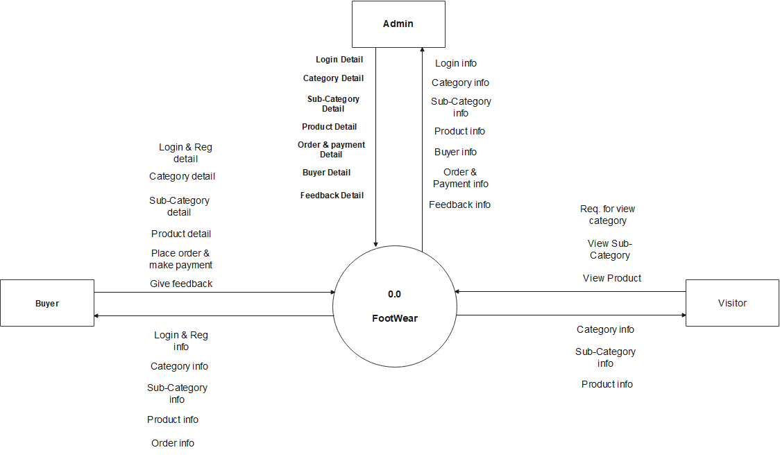
Data Flow Diagram :
Context Level:-0.0

Slide 28
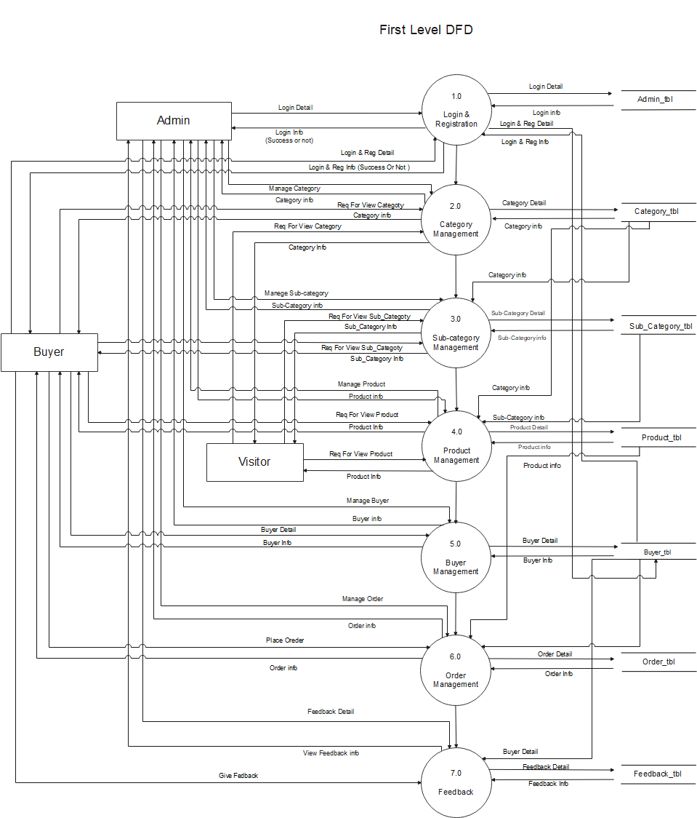
First Level:
-

Slide 29
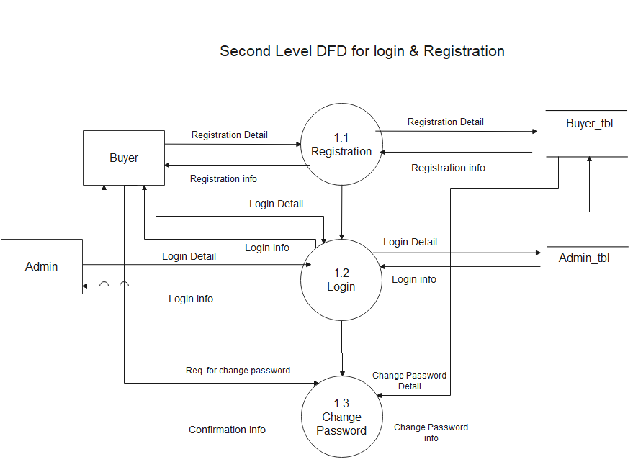
Second Level DFD for login & registration:

Slide 30
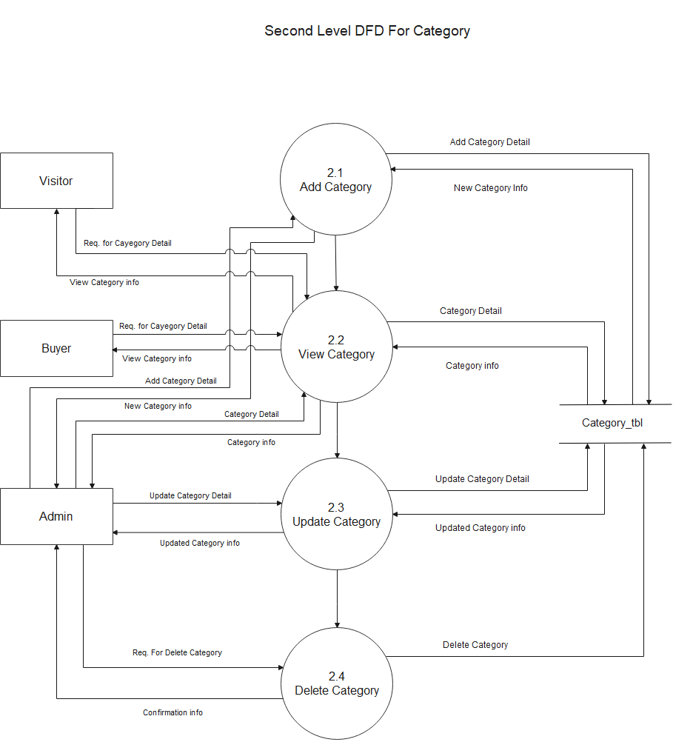
Second Level DFD for Category:-

Slide 31
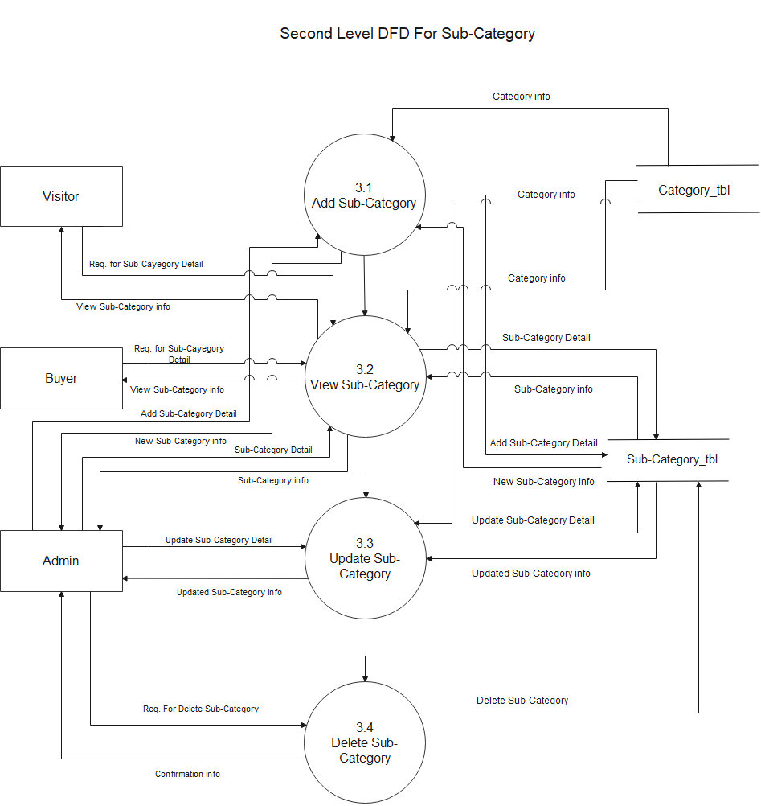
Second Level DFD for Sub-Category:-

Slide 32
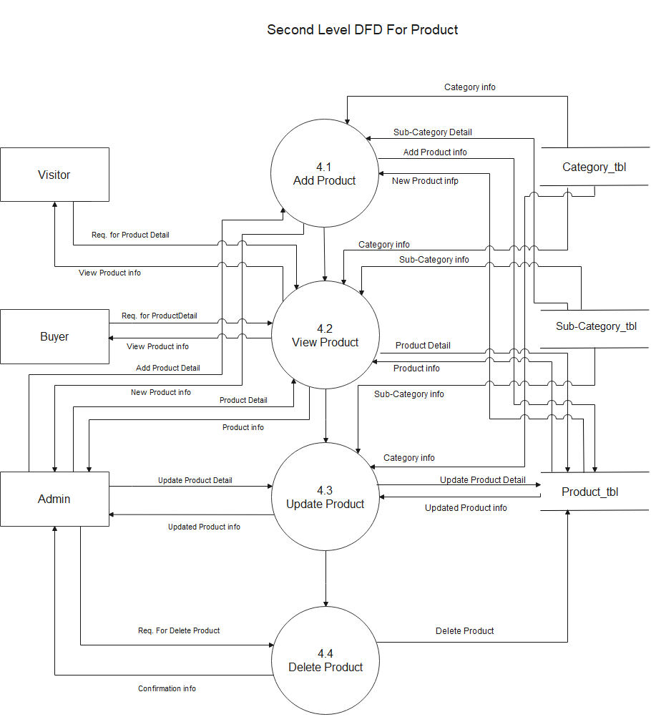
Second Level DFD for Product:-

Slide 33
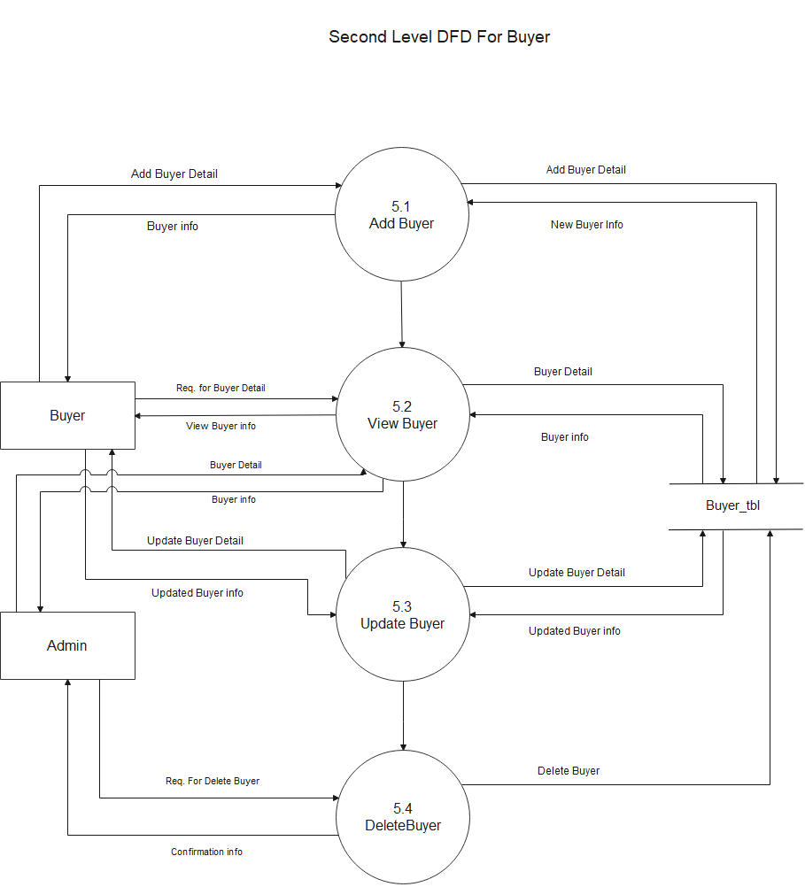
Second Level DFD for Buyer:-

Slide 34
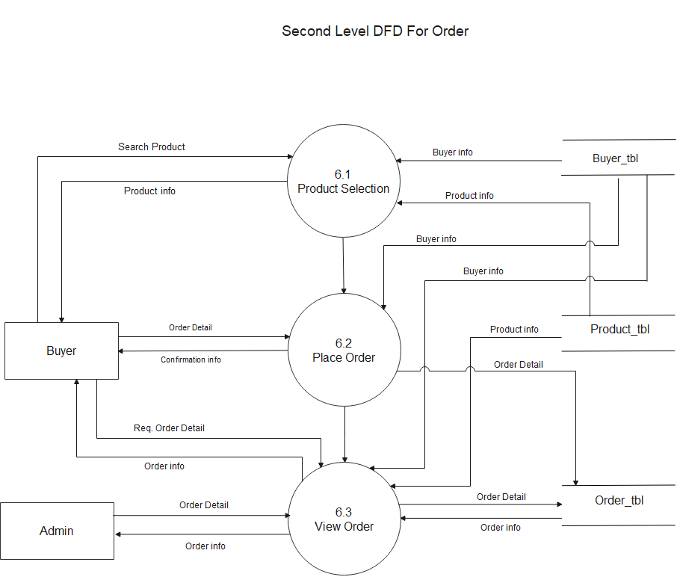
Second Level DFD for Order:-

Slide 35
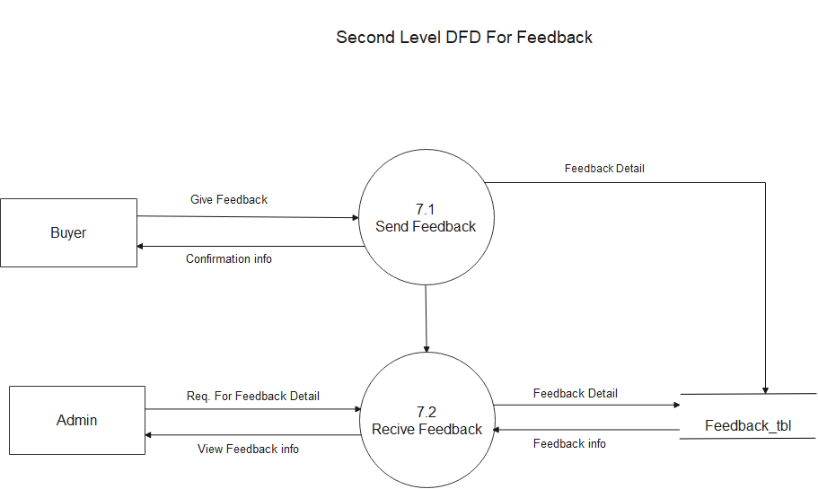
Second Level DFD for Feedback:-

Slide 36
DATA DICTIONARY

Slide 37
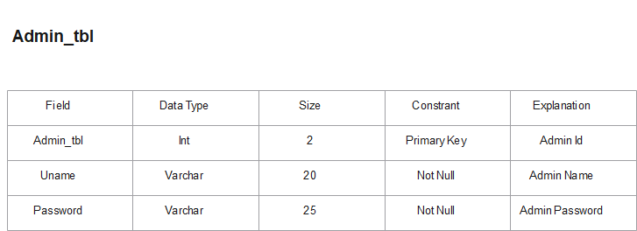
Data Dictionary:
Table 1:- Admin_tbl

Slide 38
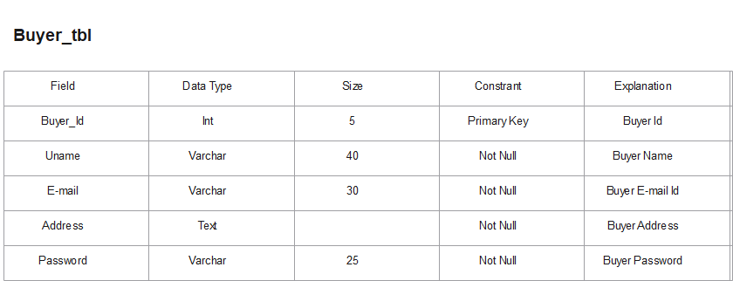
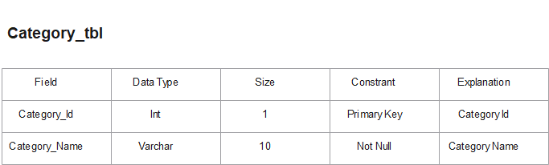
Table 2:- Buyer_tbl
Table 3:- Category_tbl

Slide 39
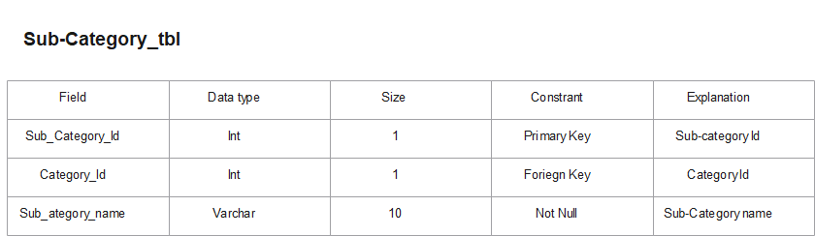
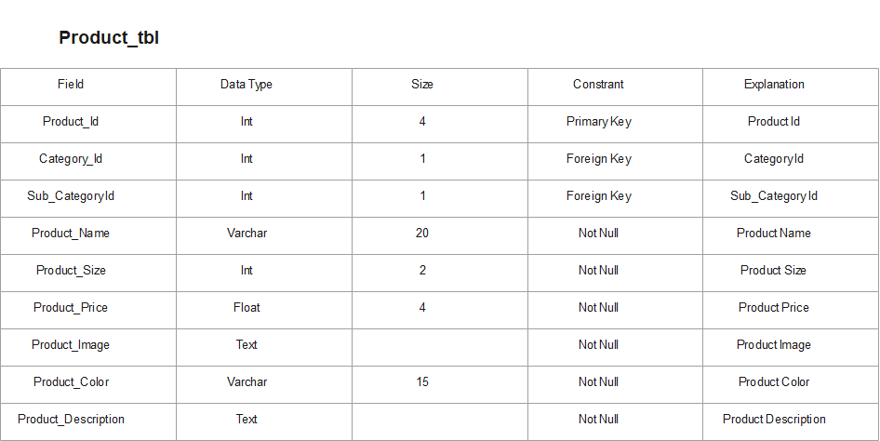
Table 4:- Sub_Category_tbl
Table 5:- Product_tbl

Slide 40
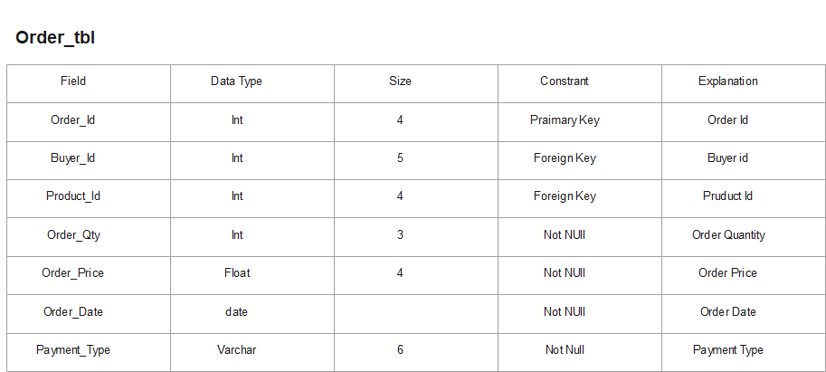
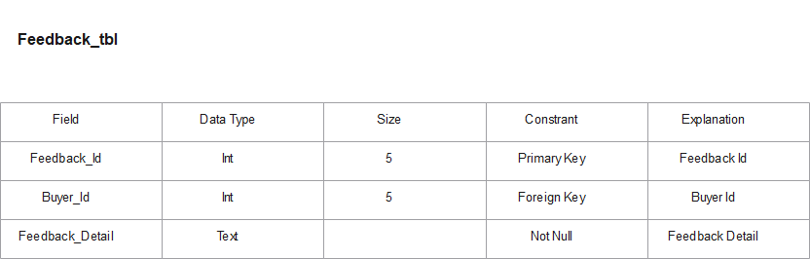
Table 6:- Order & Payment_tbl
Table 7:- Feedback_tbl

Slide 41
Screen Shots

Slide 42
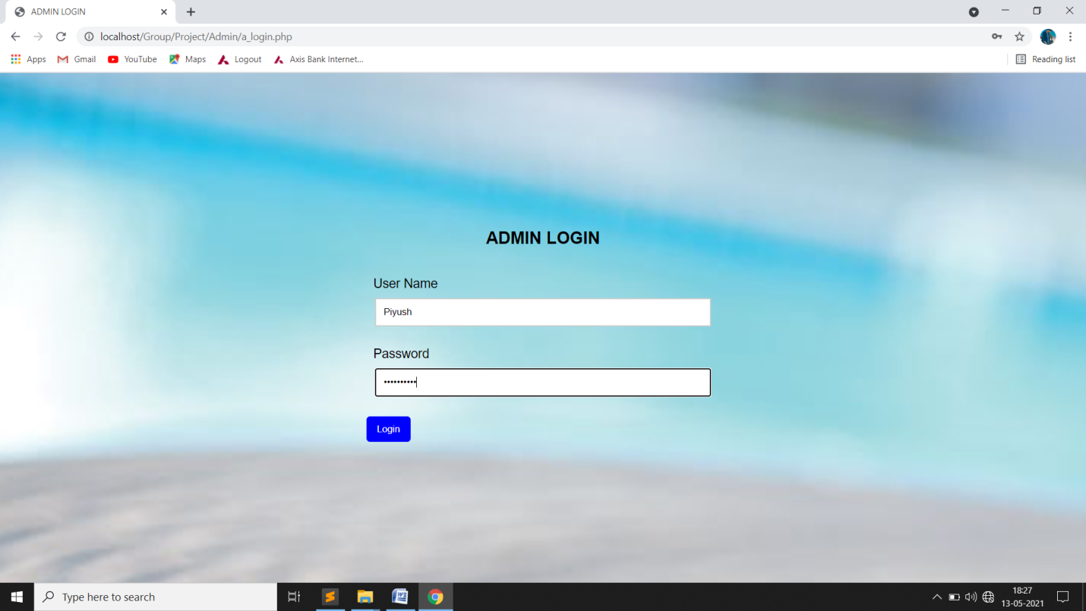
Admin
Login Page:-

Slide 43
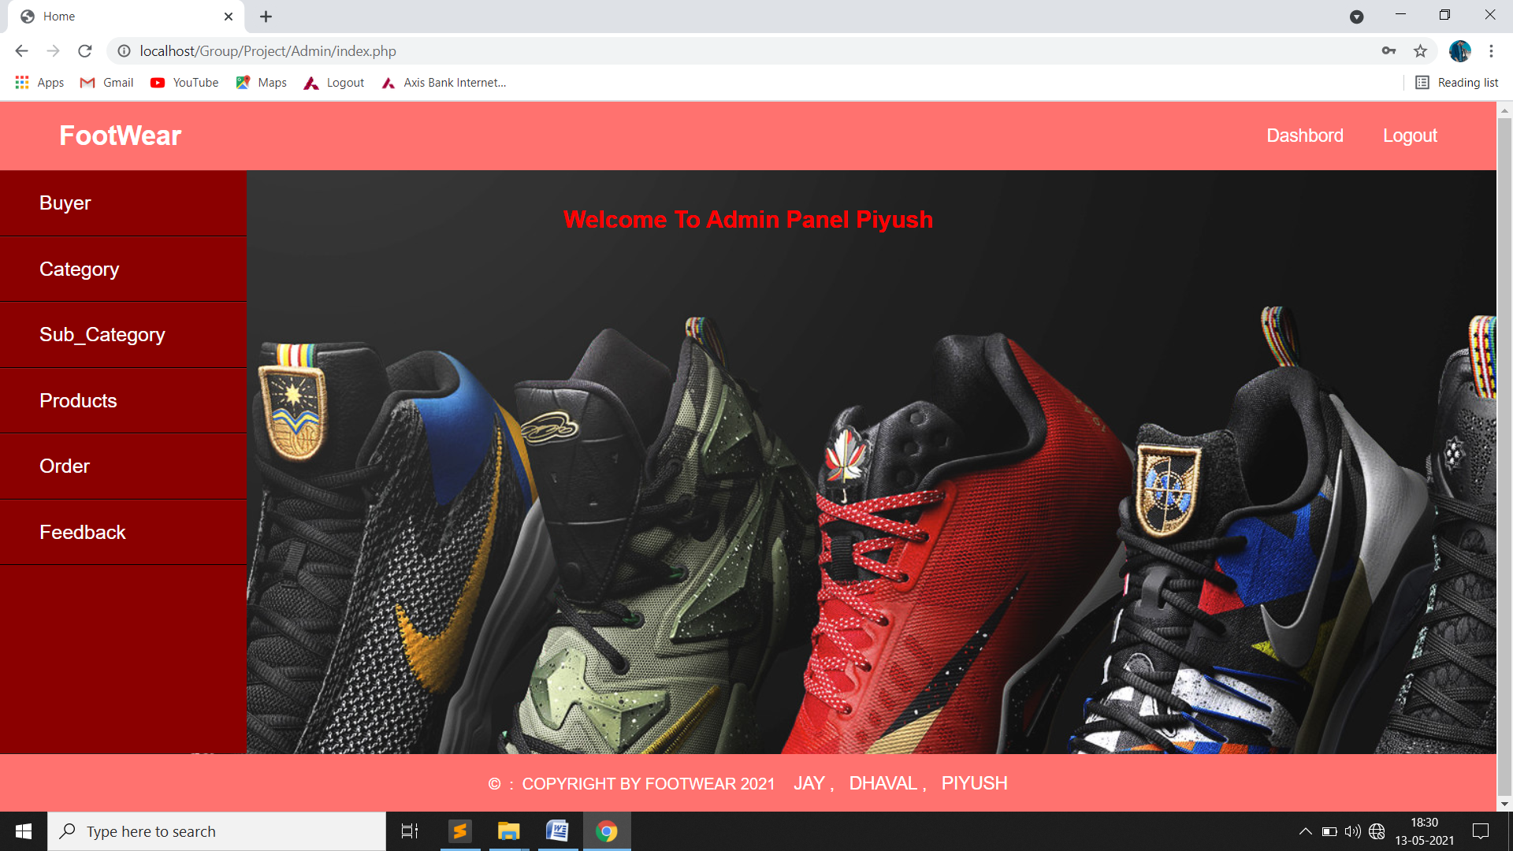
Home Page:-

Slide 44
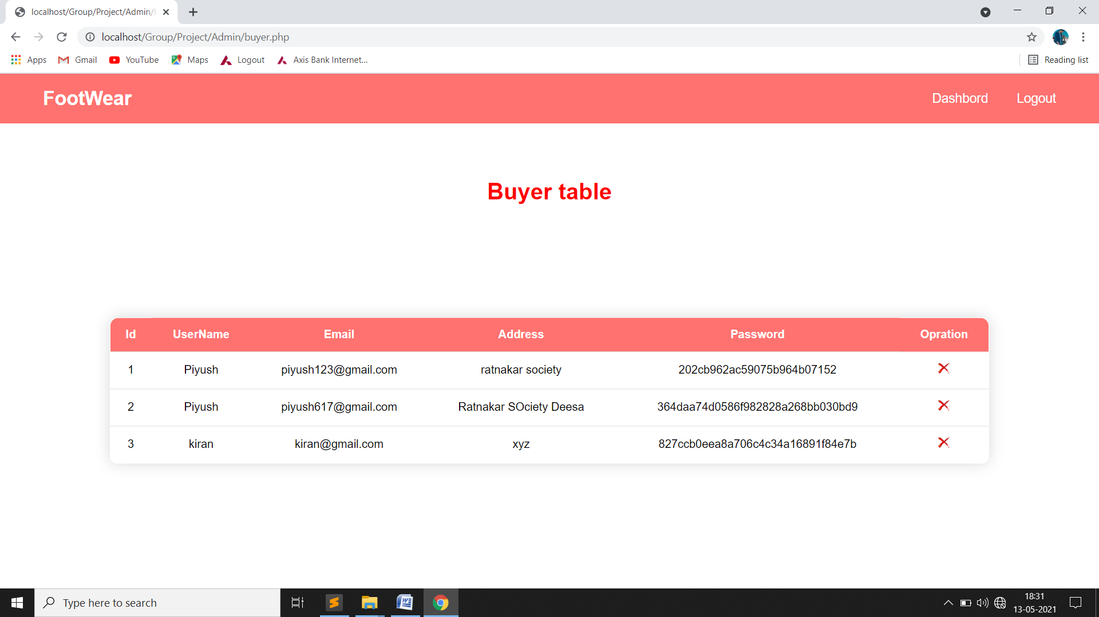
Buyer Page:-

Slide 45
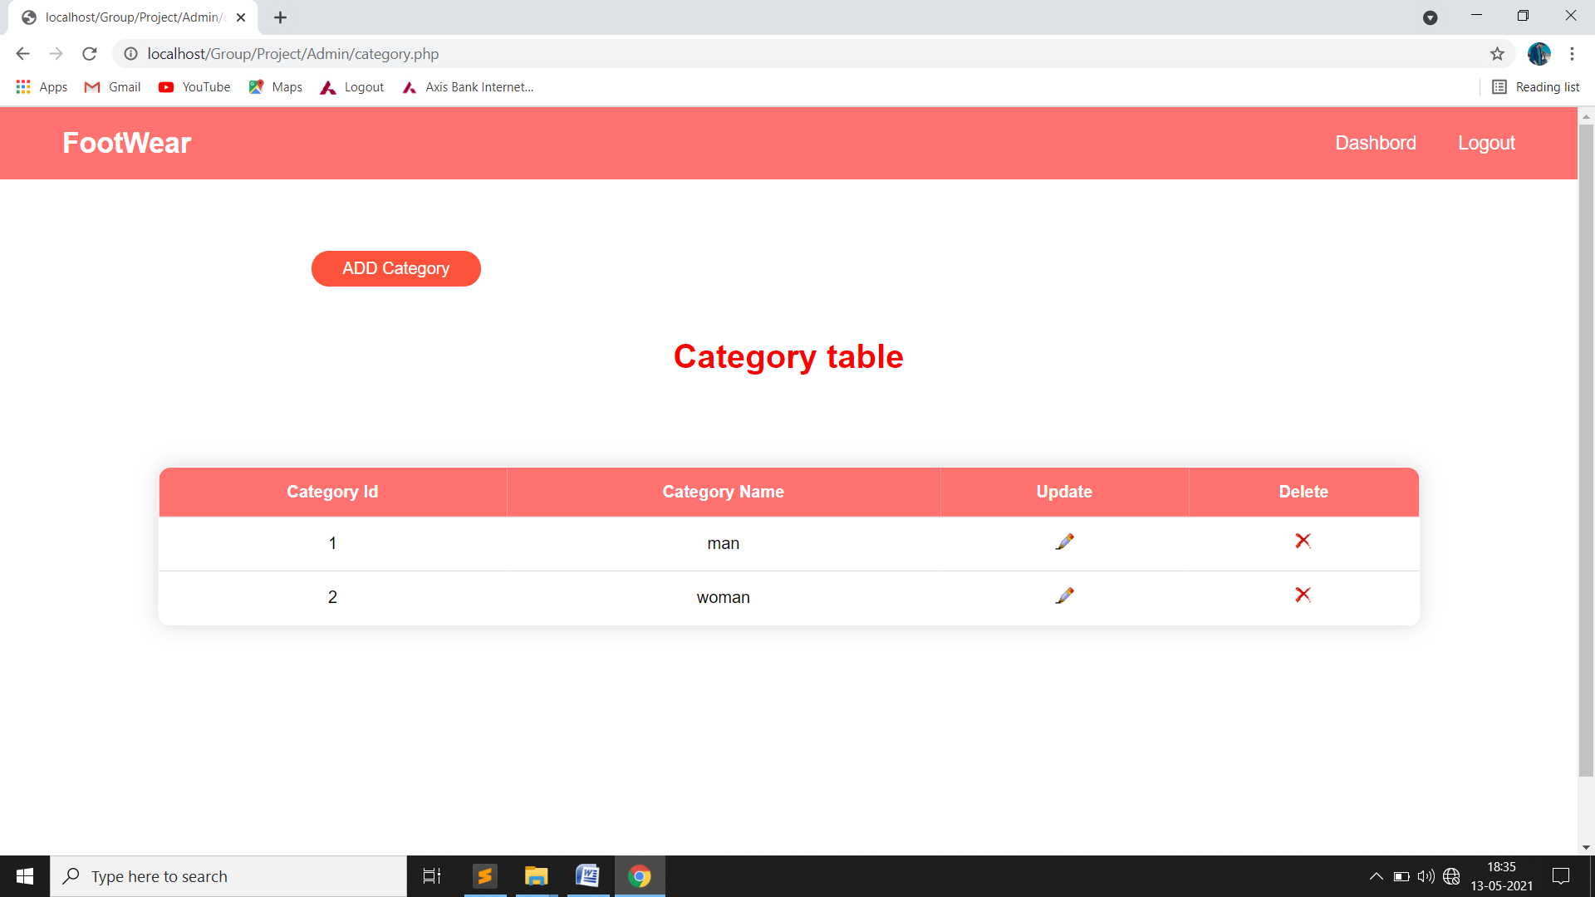
Category Page:-

Slide 46
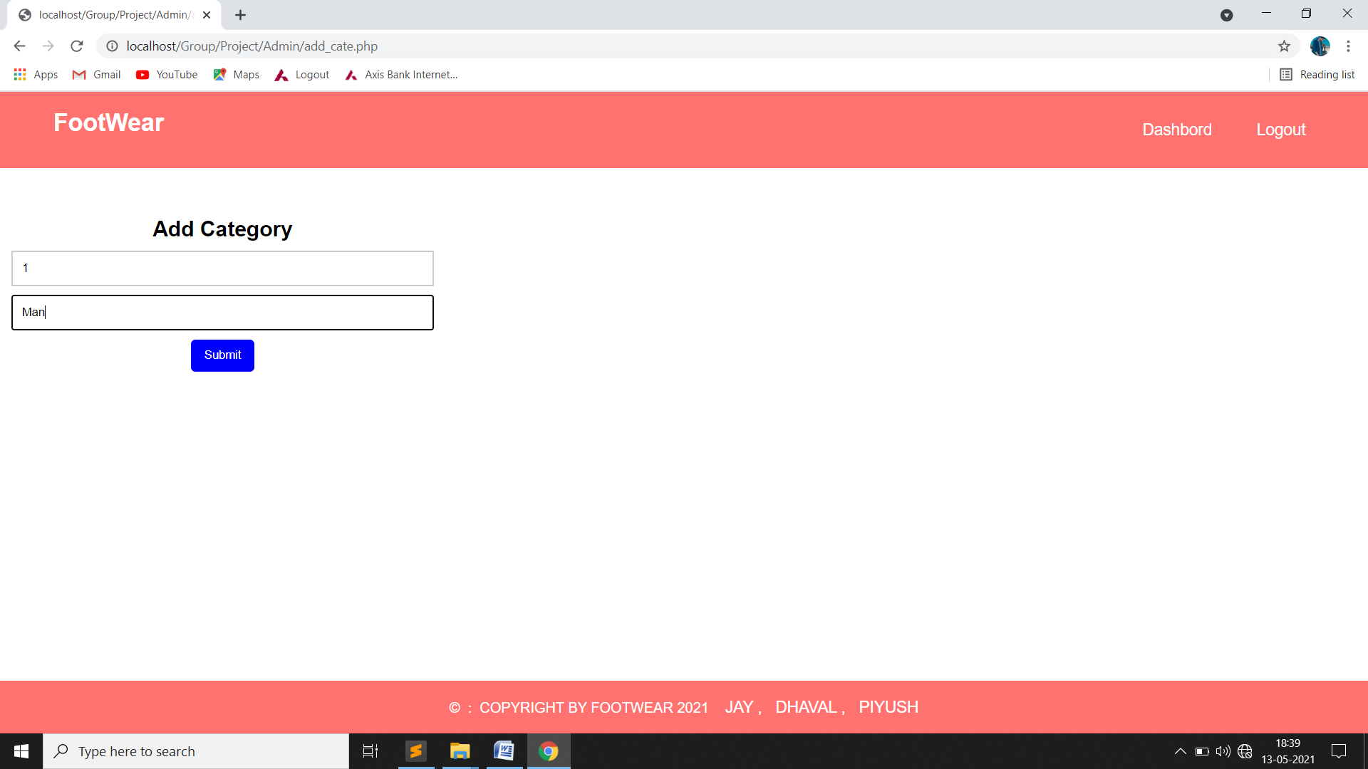
Add Category Page:-

Slide 47
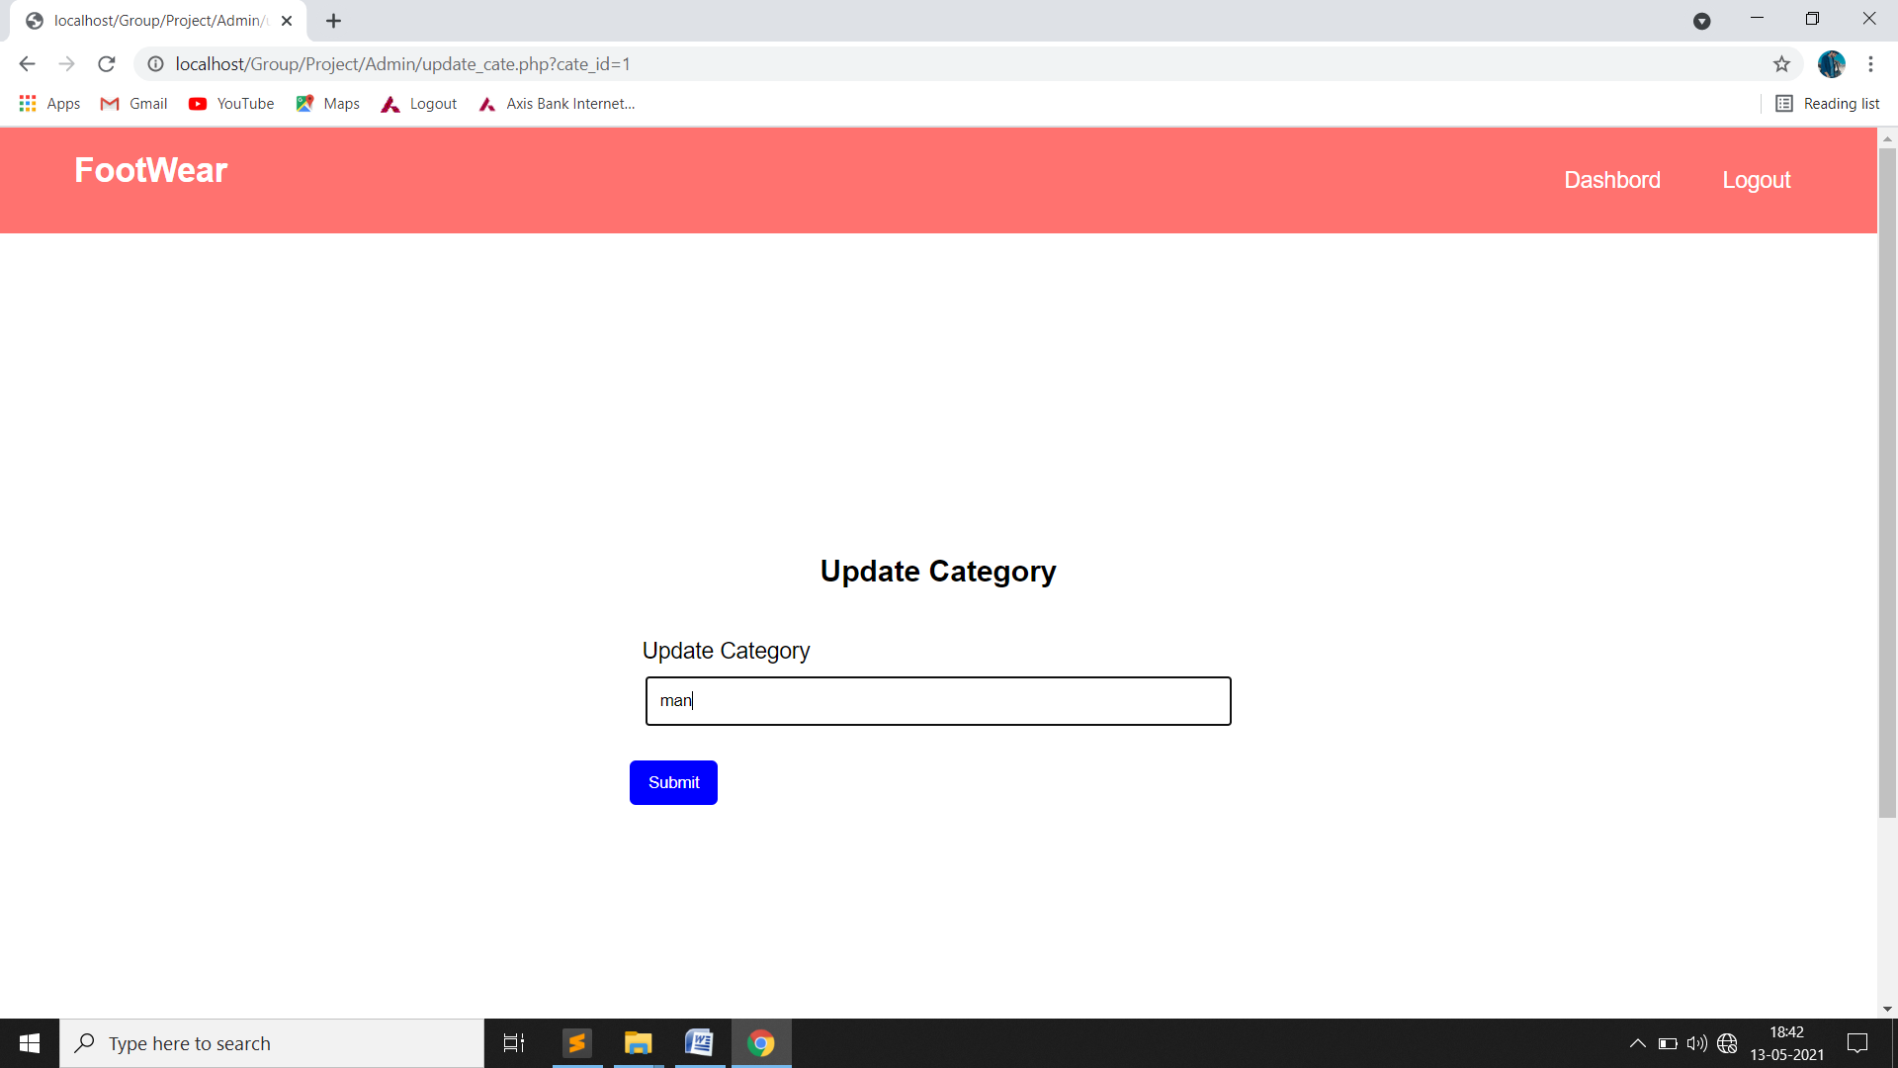
Update Category Page:-

Slide 48
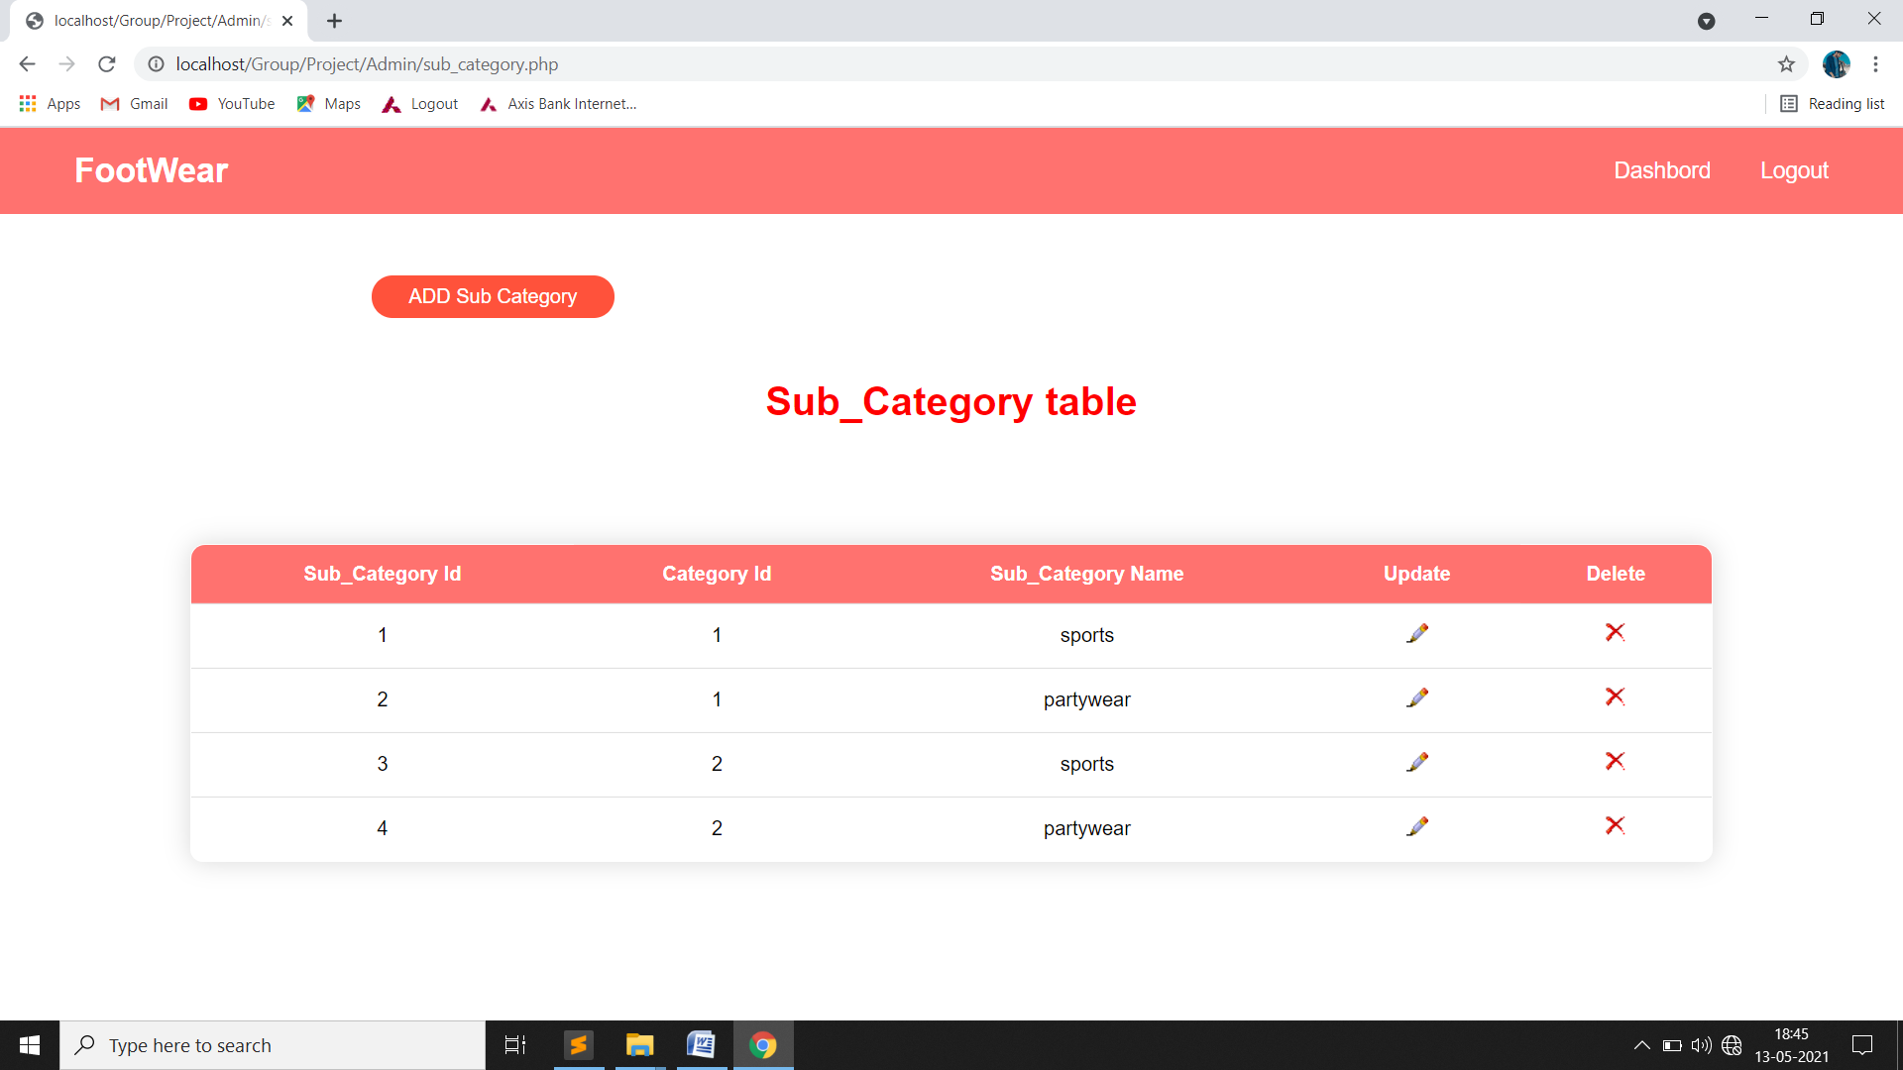
Sub-Category Page:-

Slide 49
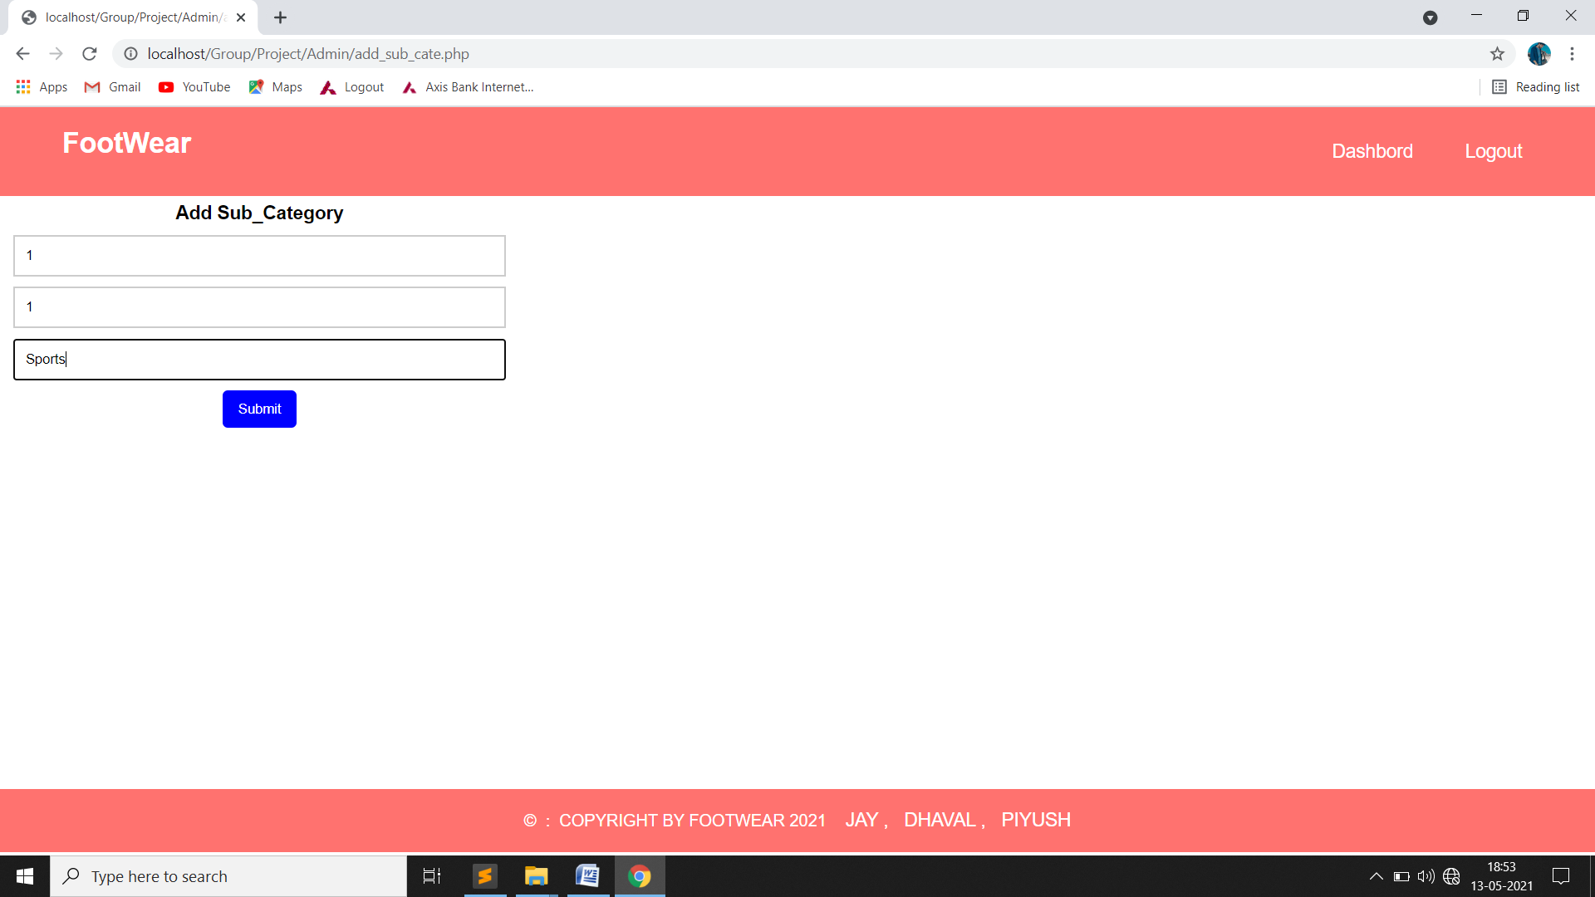
Add Sub-Catrgory Page:-

Slide 50

Update Sub-Category :-

Slide 51
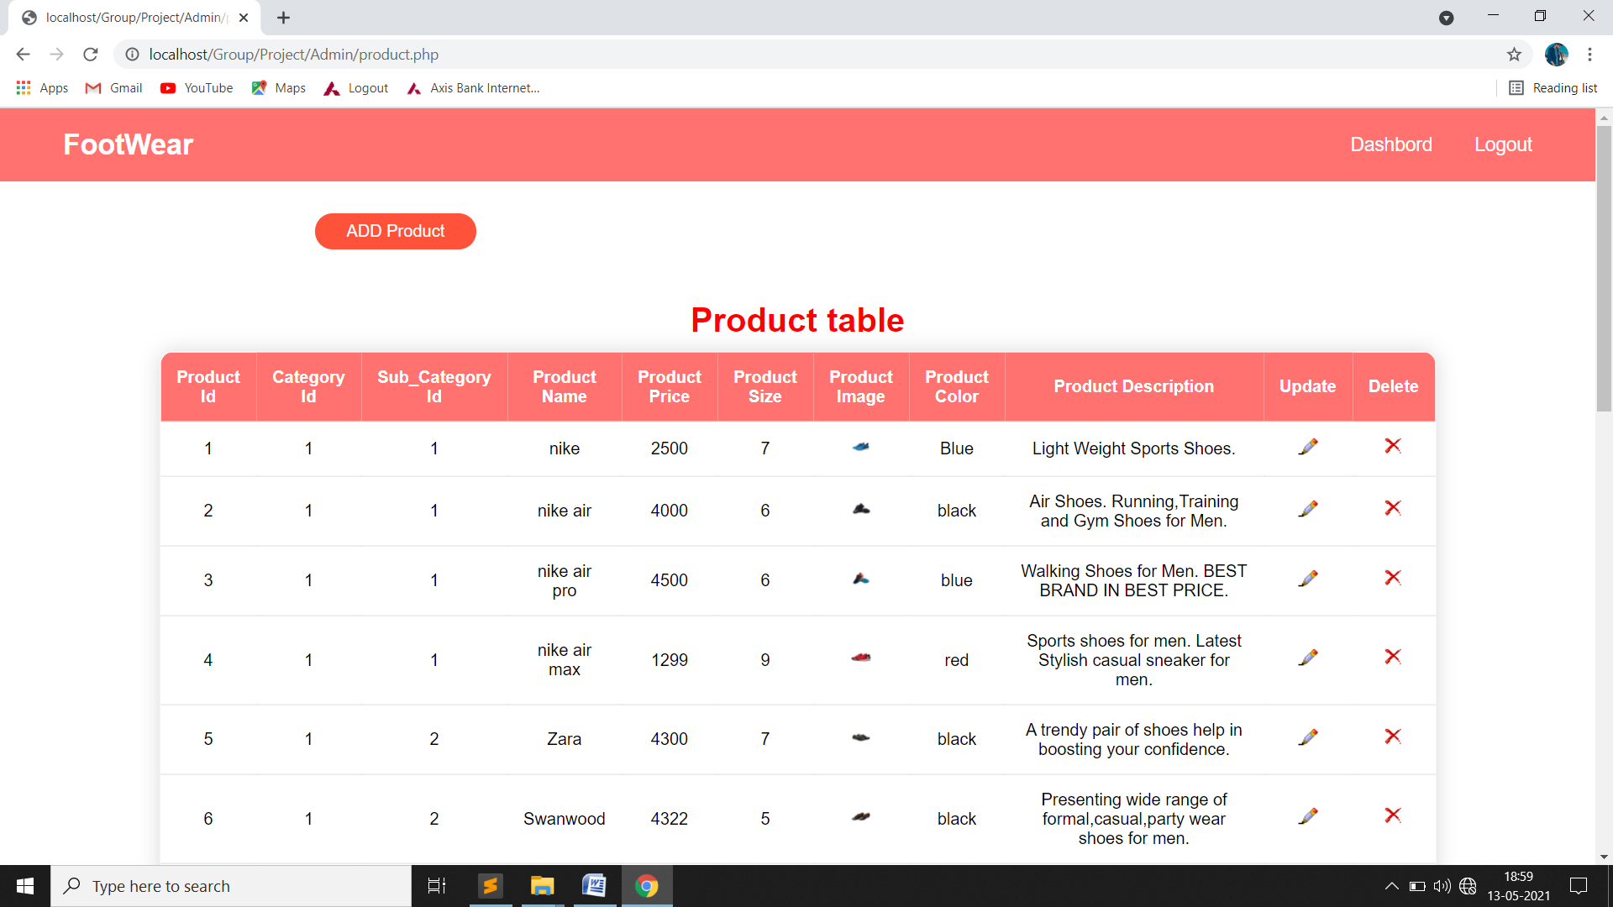
Product Page:-

Slide 52
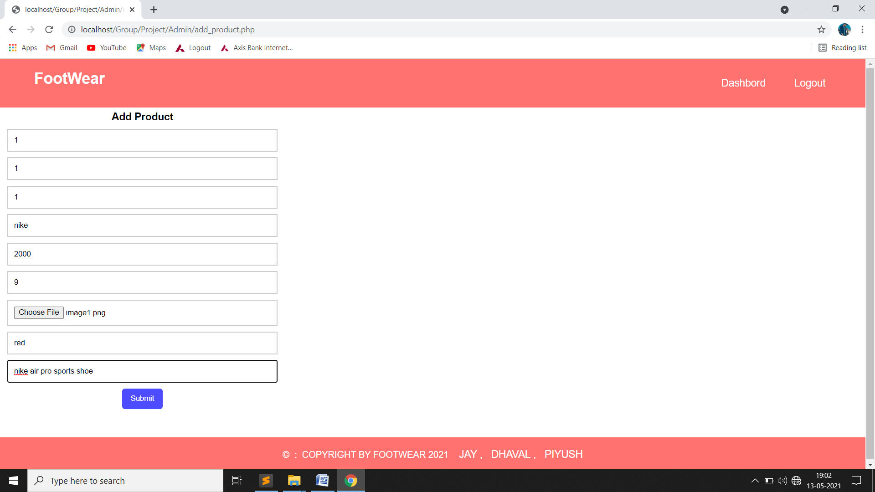
Add Product Page:-

Slide 53
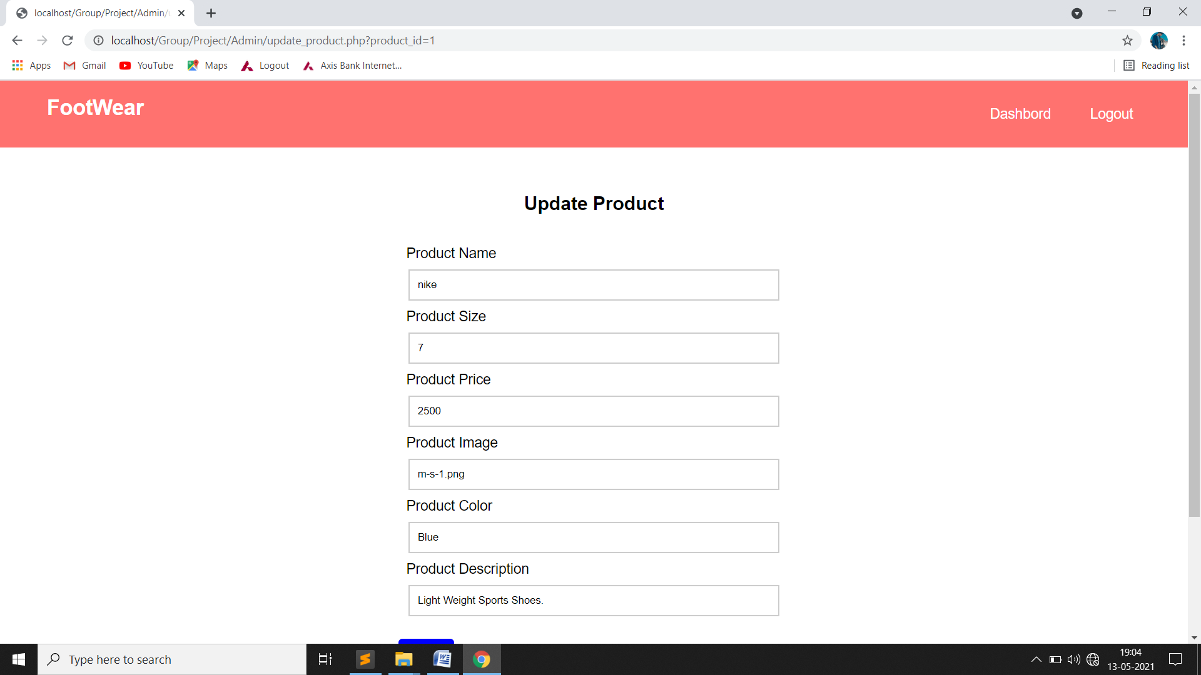
Update Product Page:-

Slide 54
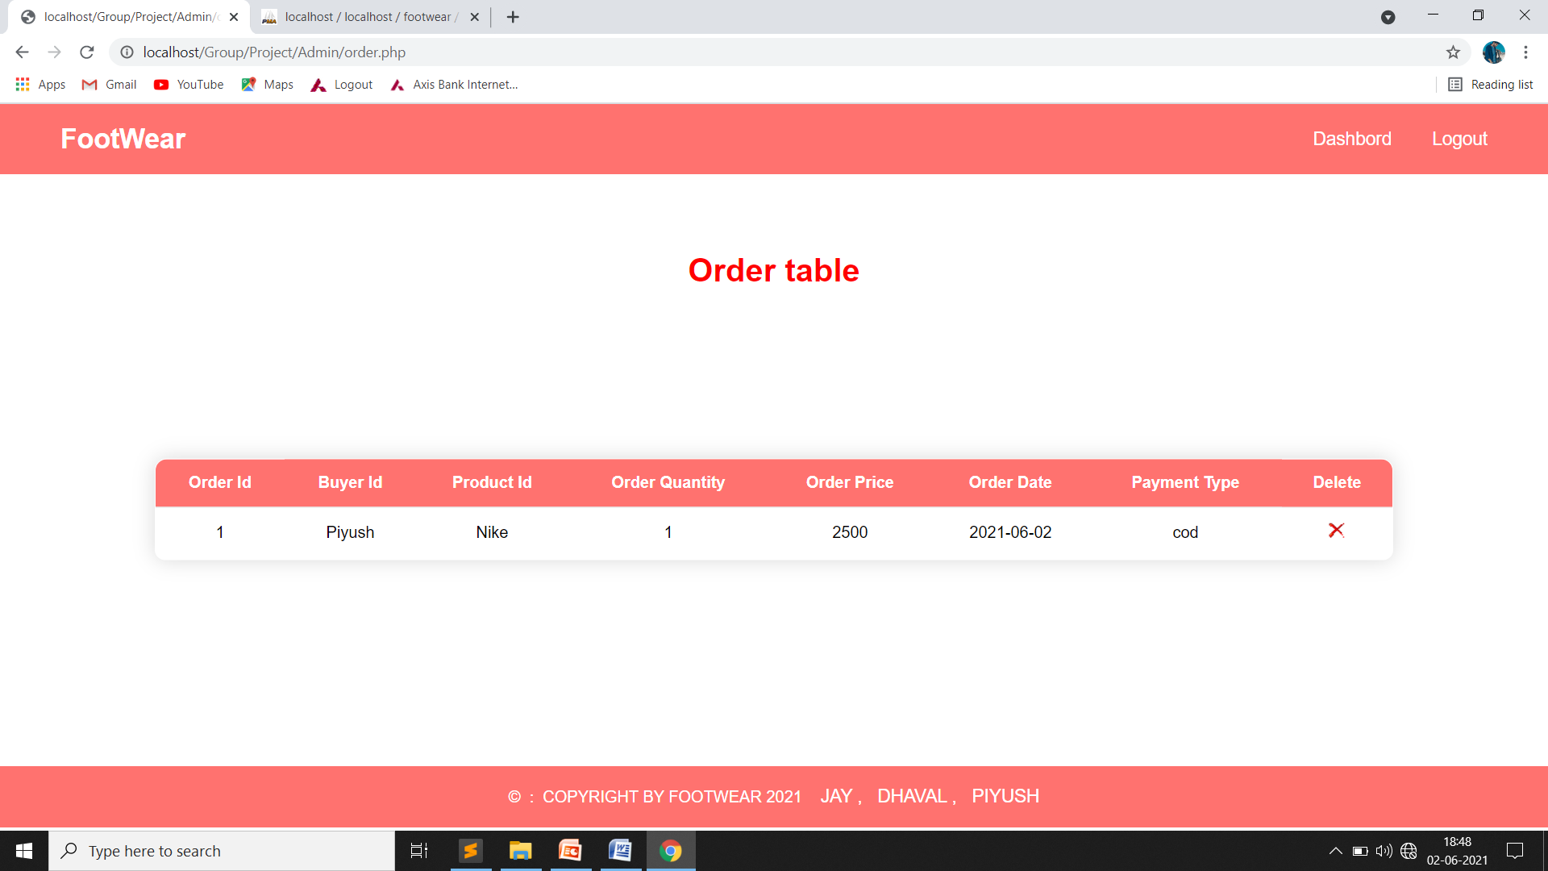
Order Page:-

Slide 55

Feedback Page:-

Slide 56
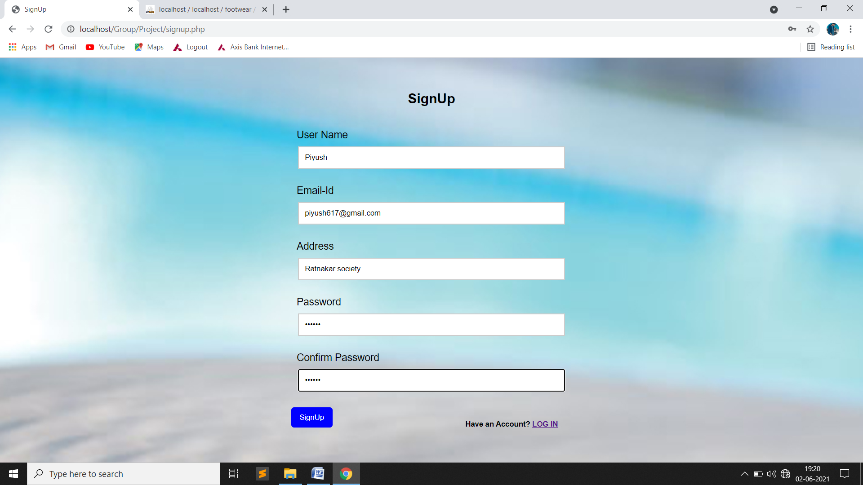
User
Sign Up Page:-

Slide 57
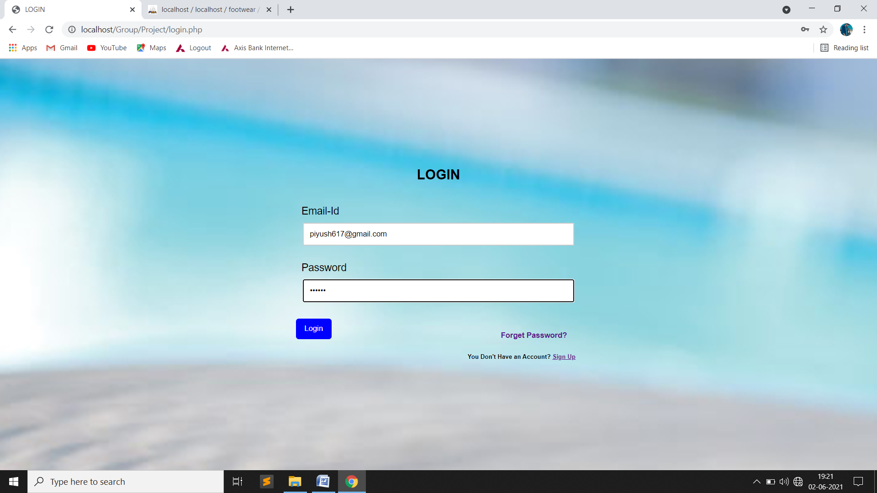
Login Page:-

Slide 58

Forget Page:-

Slide 59
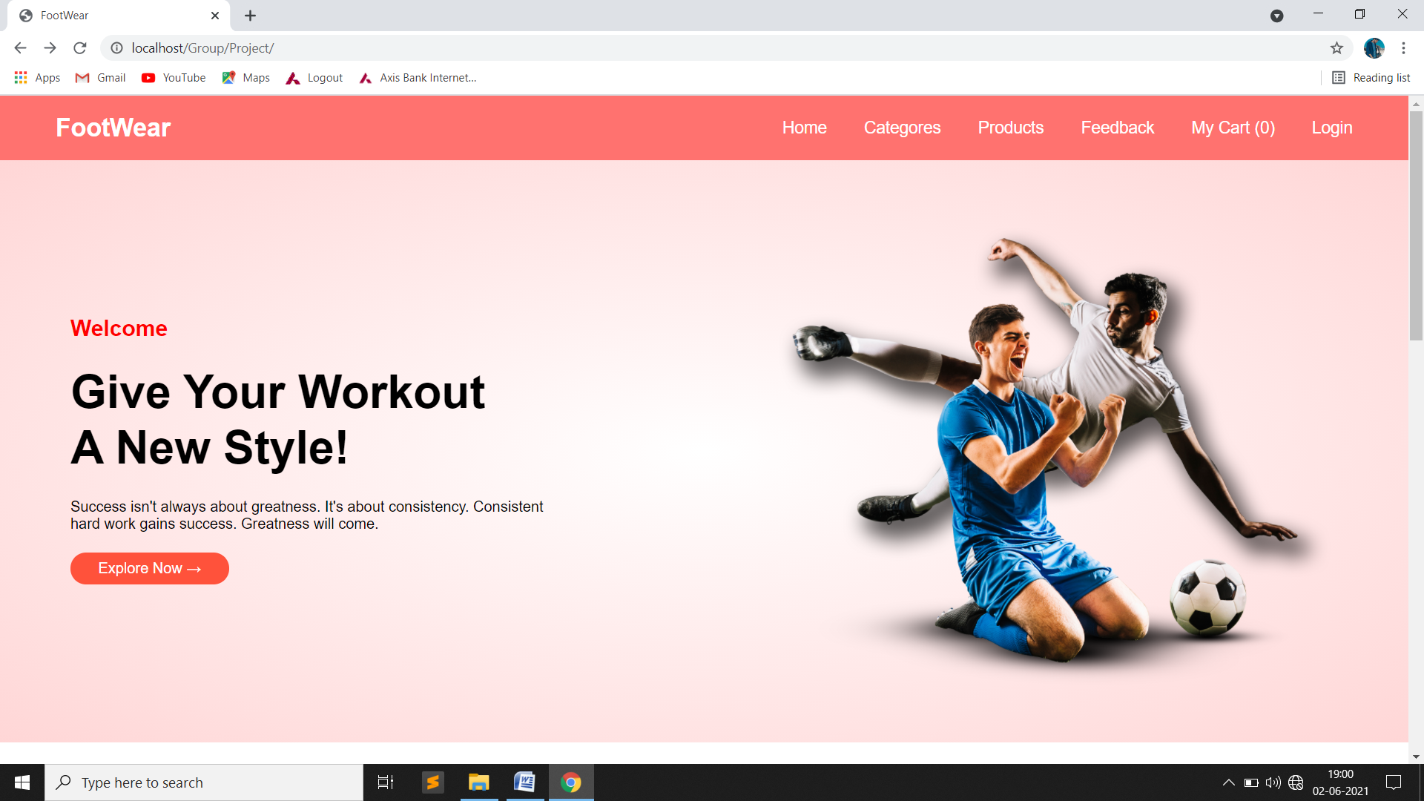
Home Page:-

Slide 60
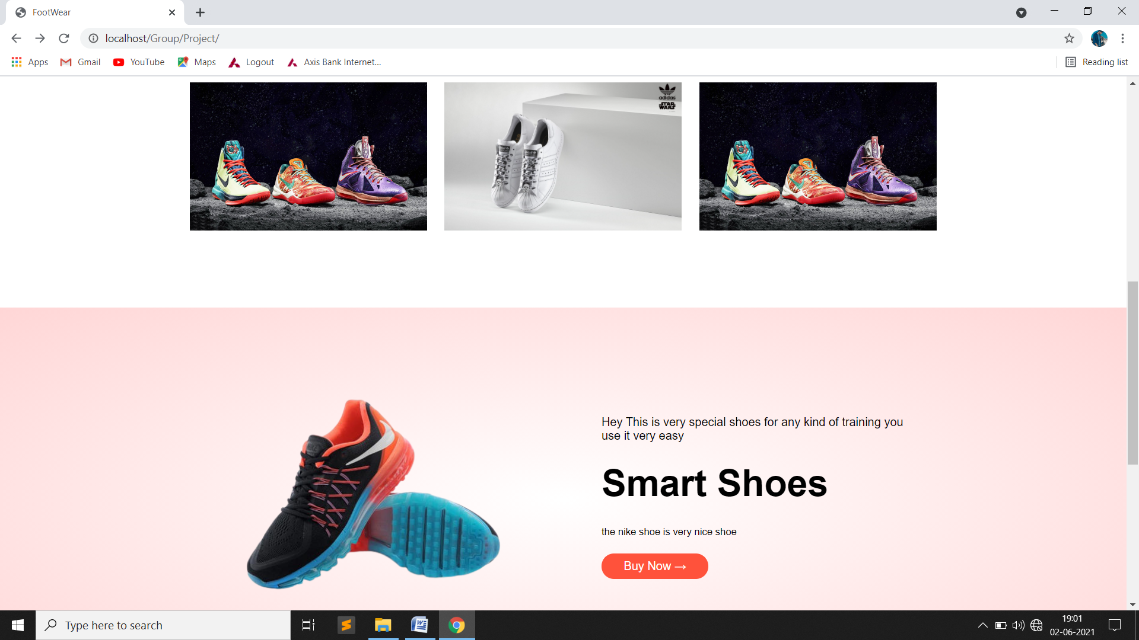
Home Page:-

Slide 61
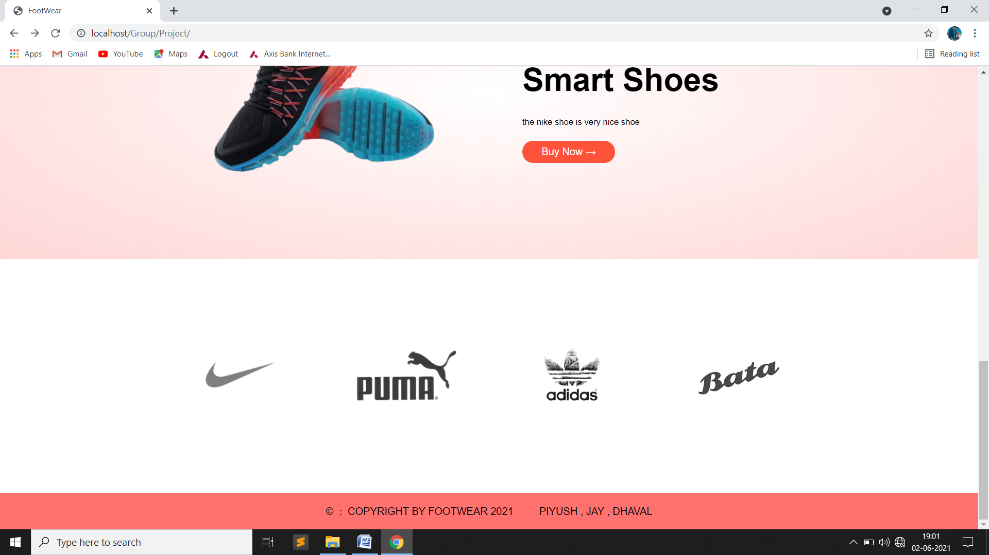
Home Page:-

Slide 62
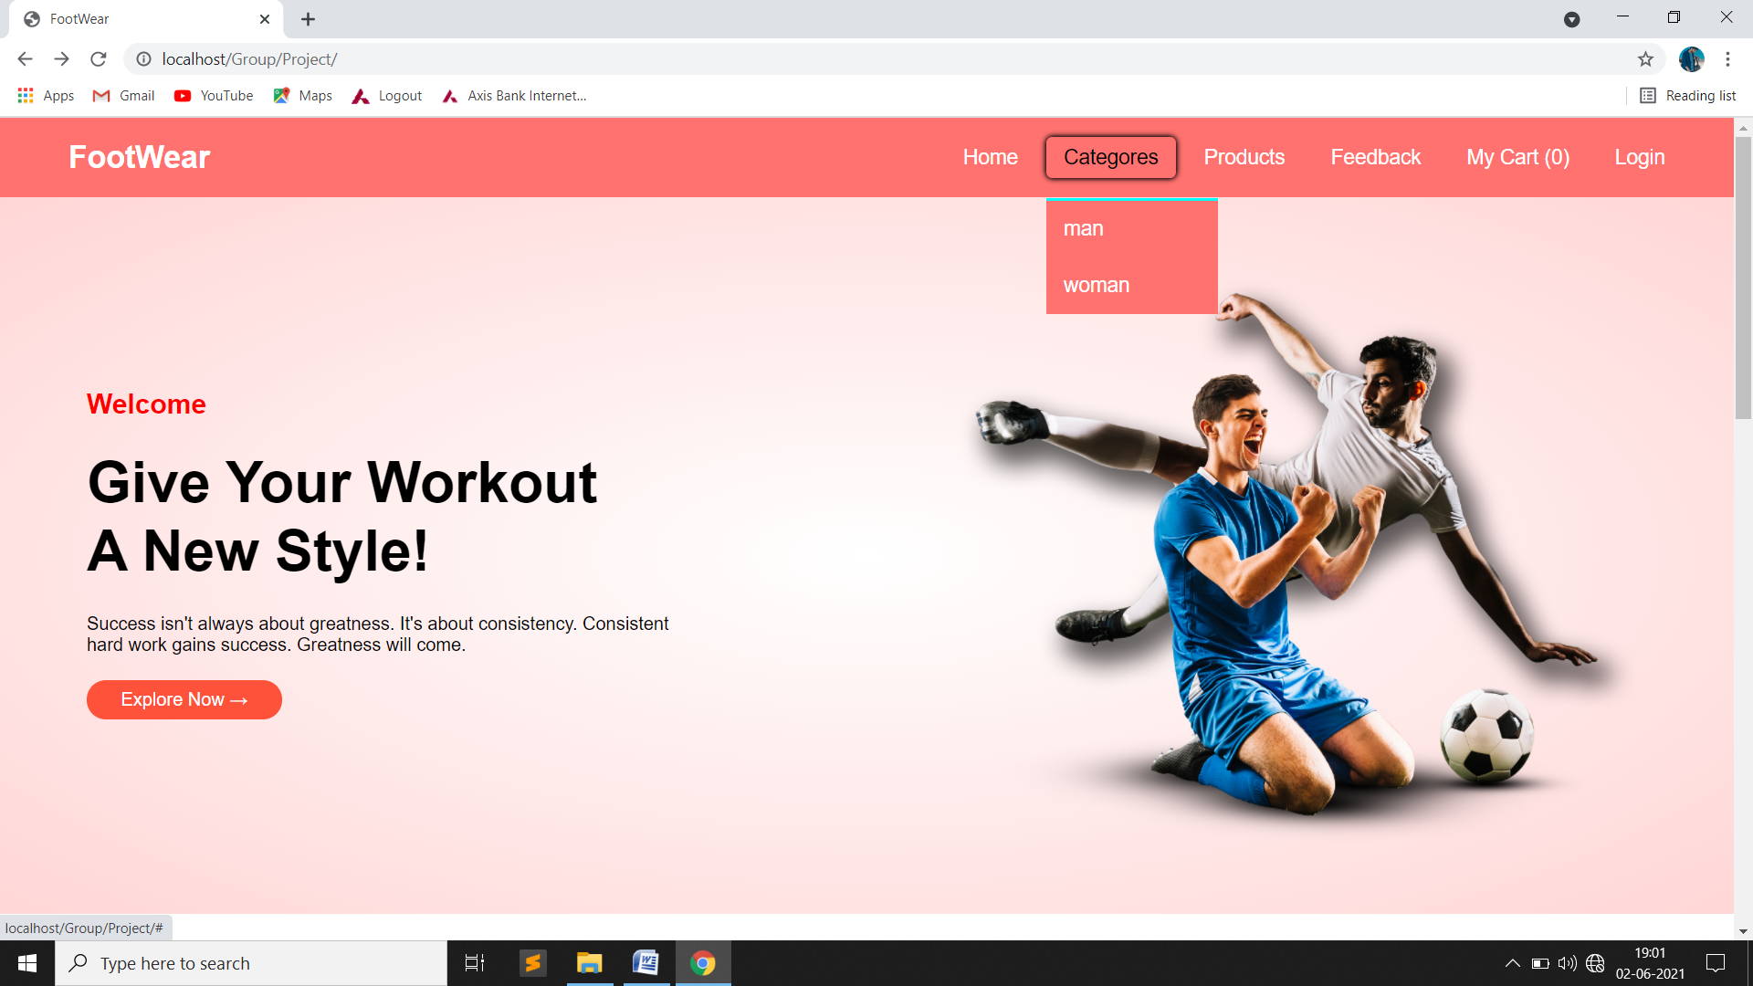
Category :-

Slide 63
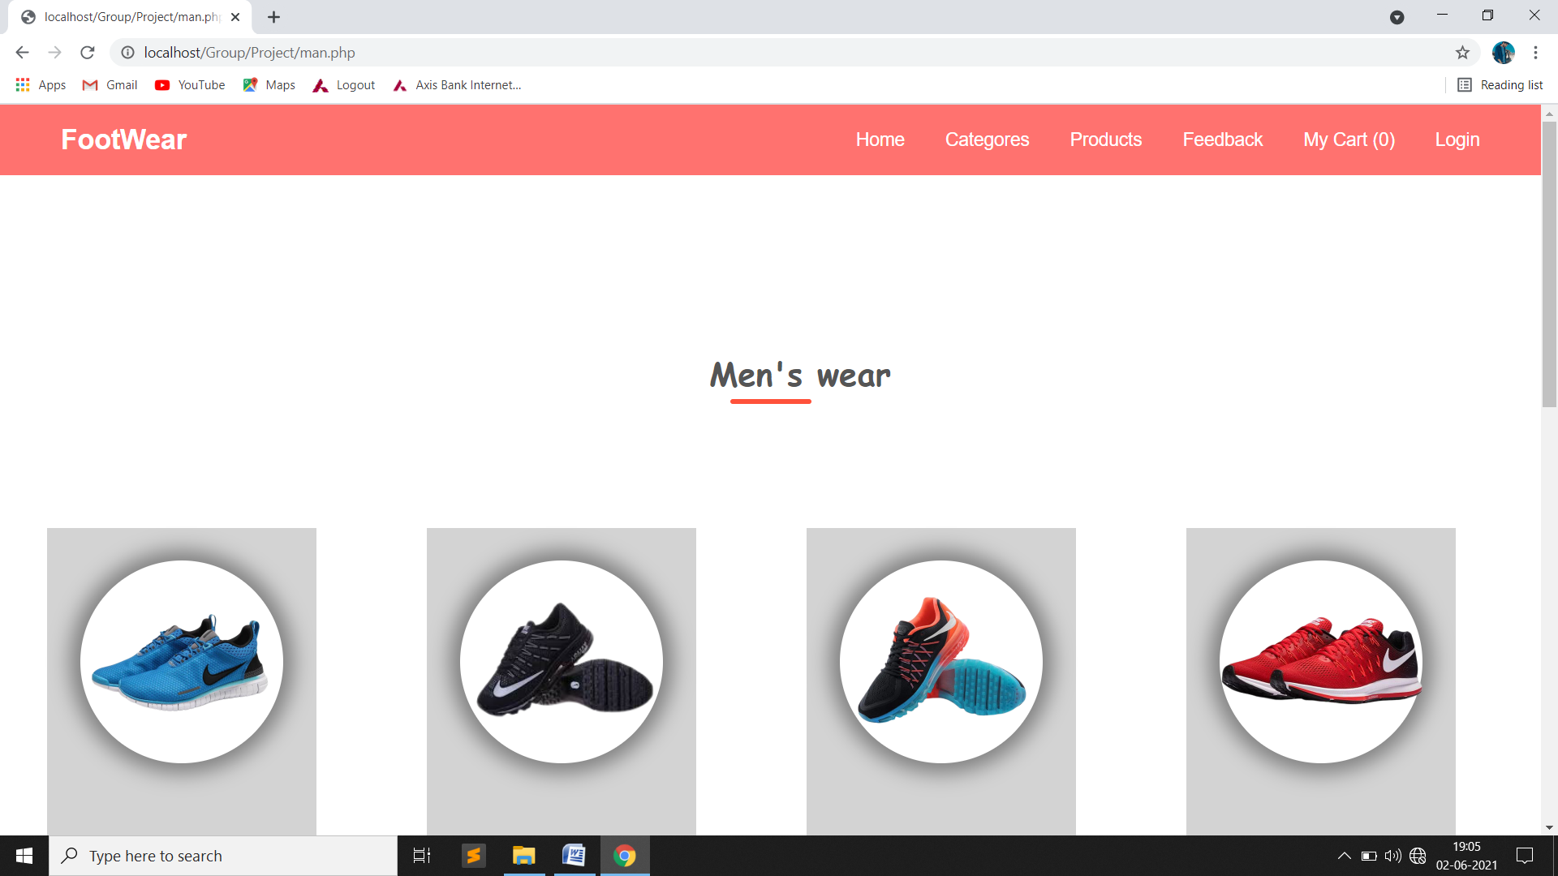
Man Page:-

Slide 64
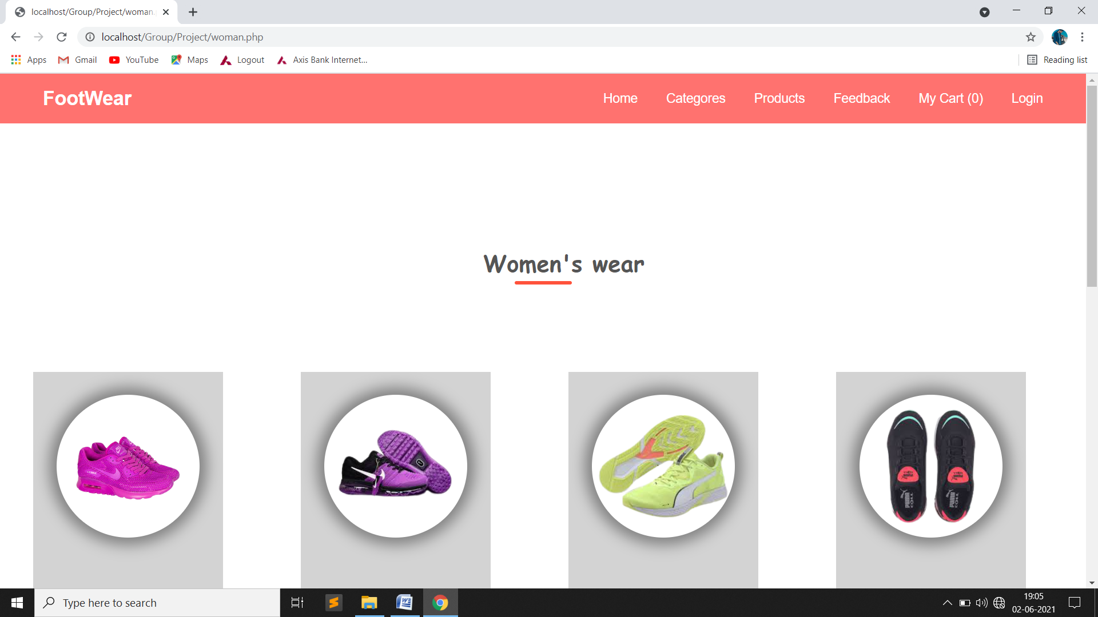
Woman Page:-

Slide 65
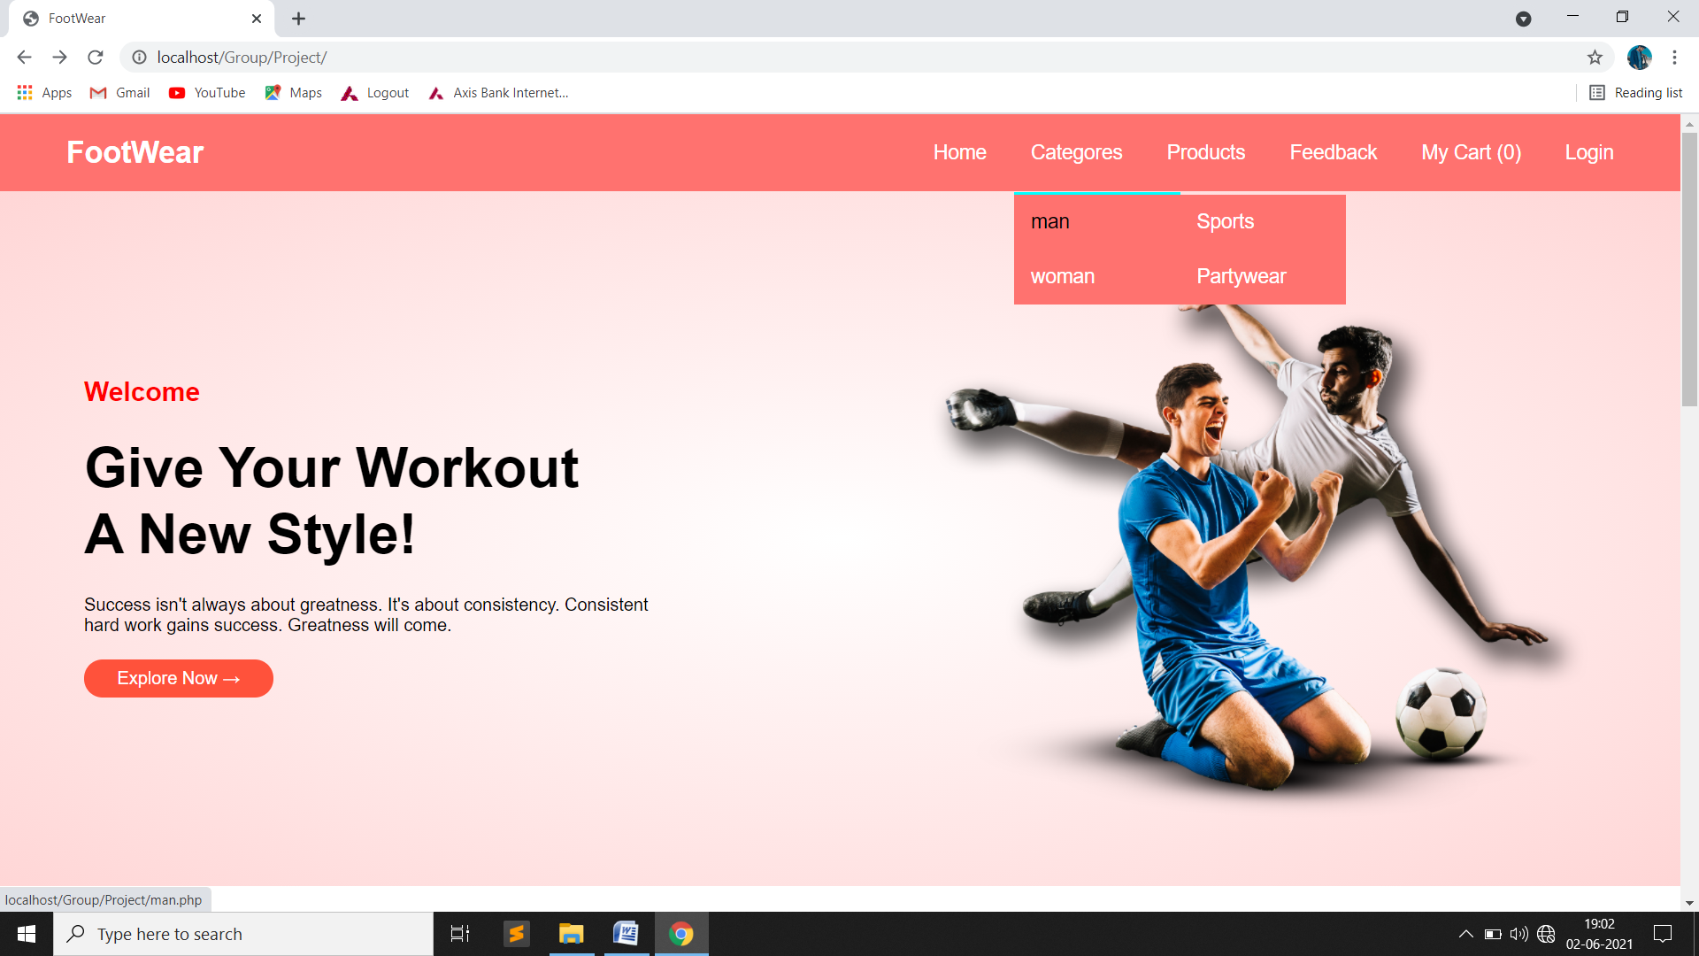
Sub-Category :-

Slide 66
Add Sub-Catrgory Page:-

Slide 67
Update Sub-Category :-

Slide 68
Product Page:-

Slide 69
Add Product Page:-

Slide 70
Update Product Page:-

Slide 71
Update Product Page:-

Slide 72
Order Page:-

Slide 73
Feedback Page:-

Slide 74
User
Sign Up Page:-

Slide 75
Login Page:-

Slide 76
Forget Page:-

Slide 77
Home Page:-

Slide 80
Category :-

Slide 81
Man Page:-

Slide 82
Woman Page:-

Slide 83
Sub-Category :-

Slide 84
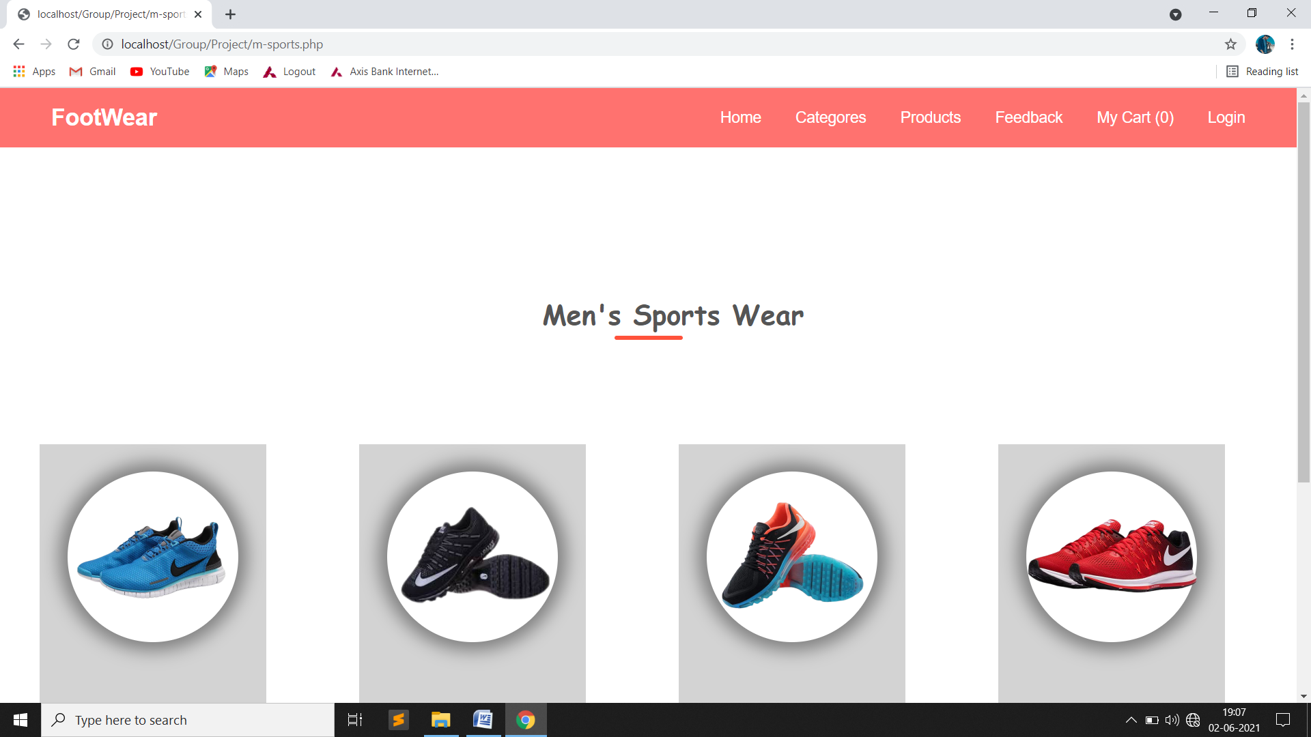
Man’s Sport’s Page:-

Slide 85
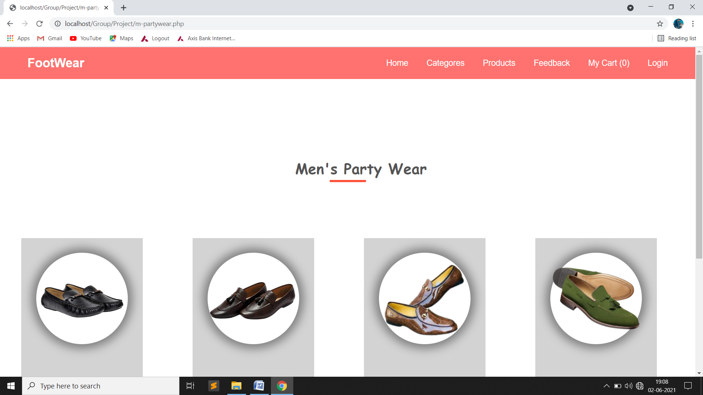
Man’s Partywear Page:-

Slide 86
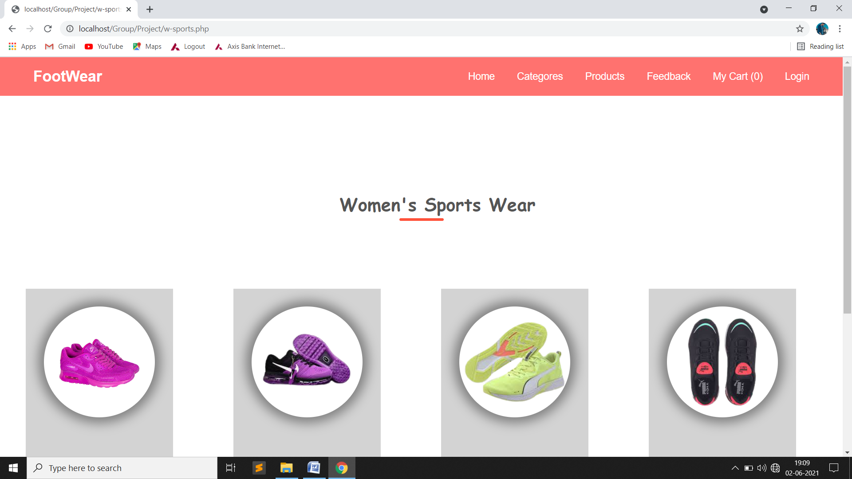
Woman’s Sport’s Page:-

Slide 87
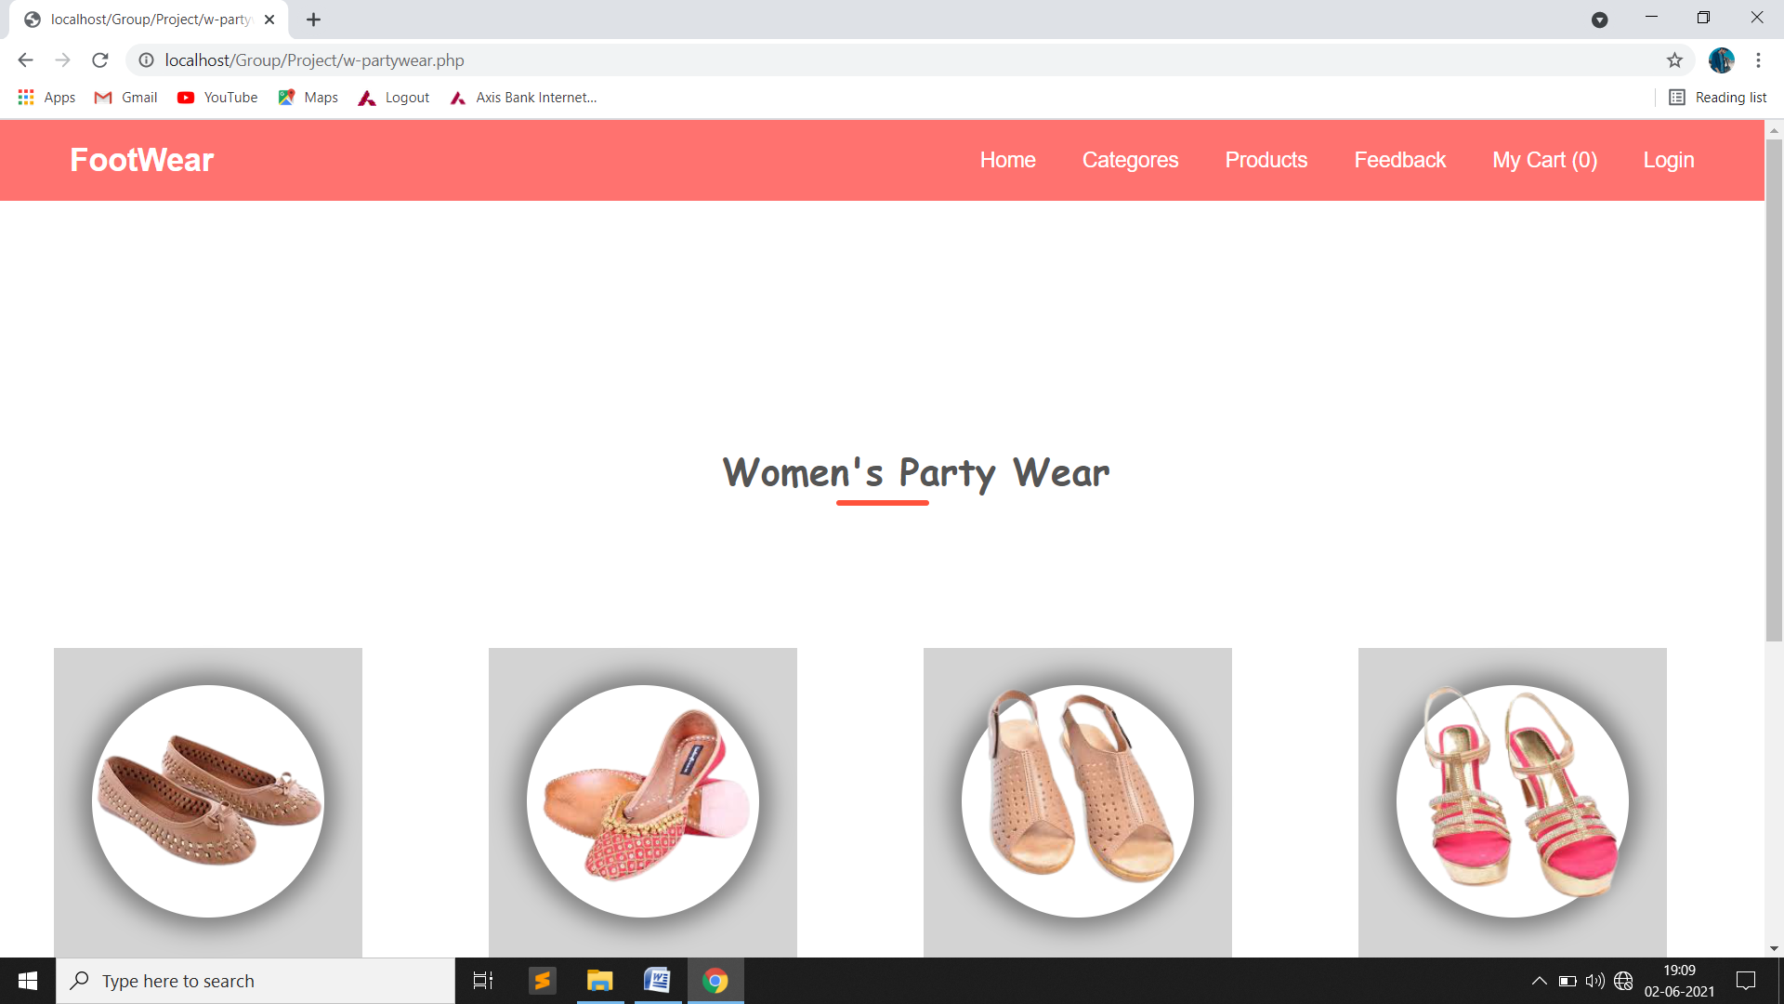
Woman’s Partywear Page:-

Slide 88
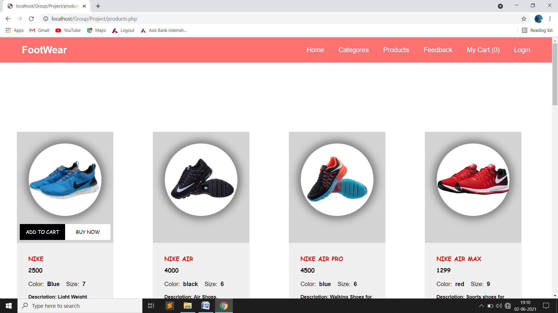
Products Page:-

Slide 89
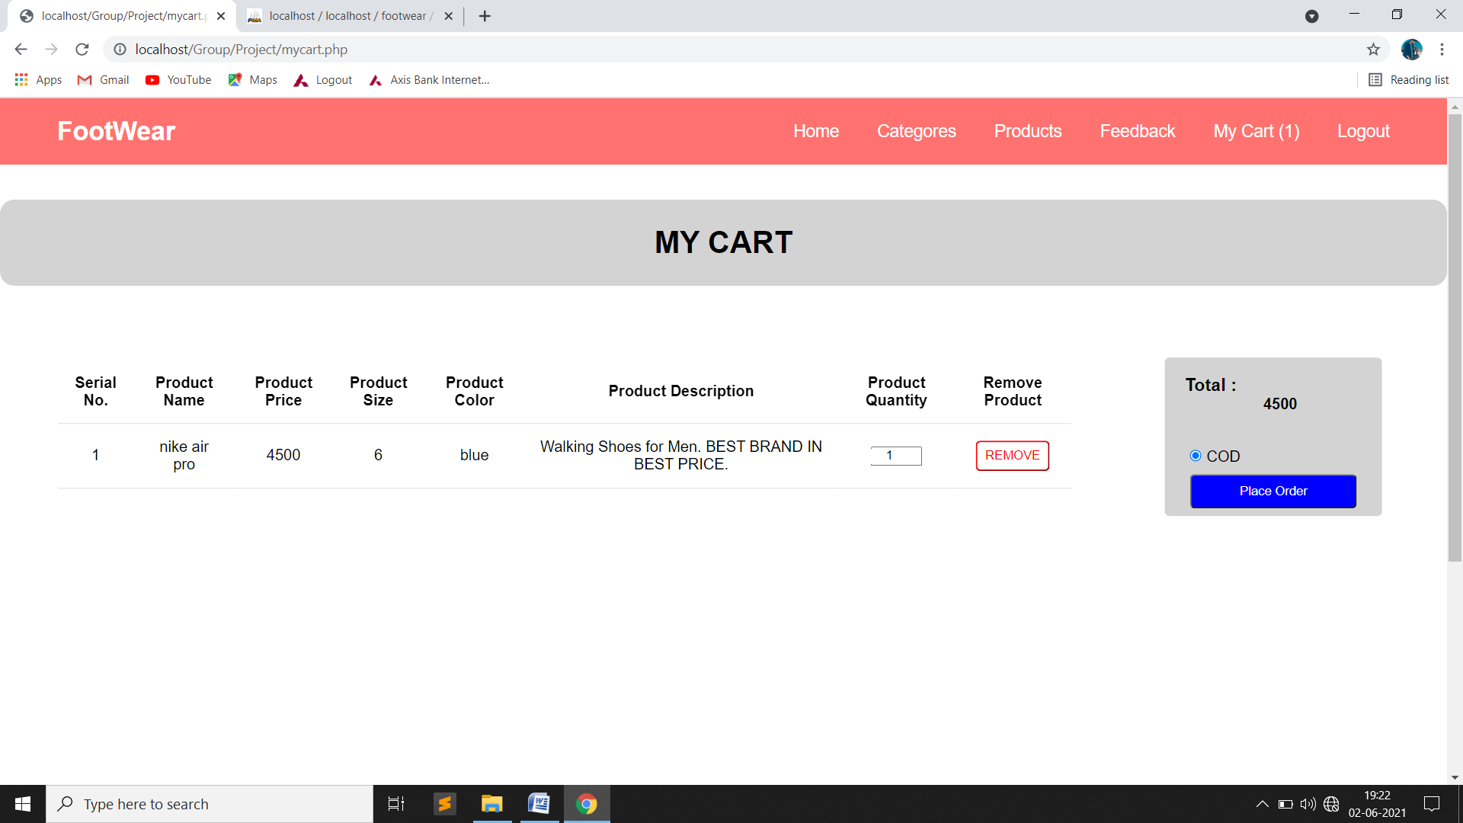
Add To Cart Page:-

Slide 90
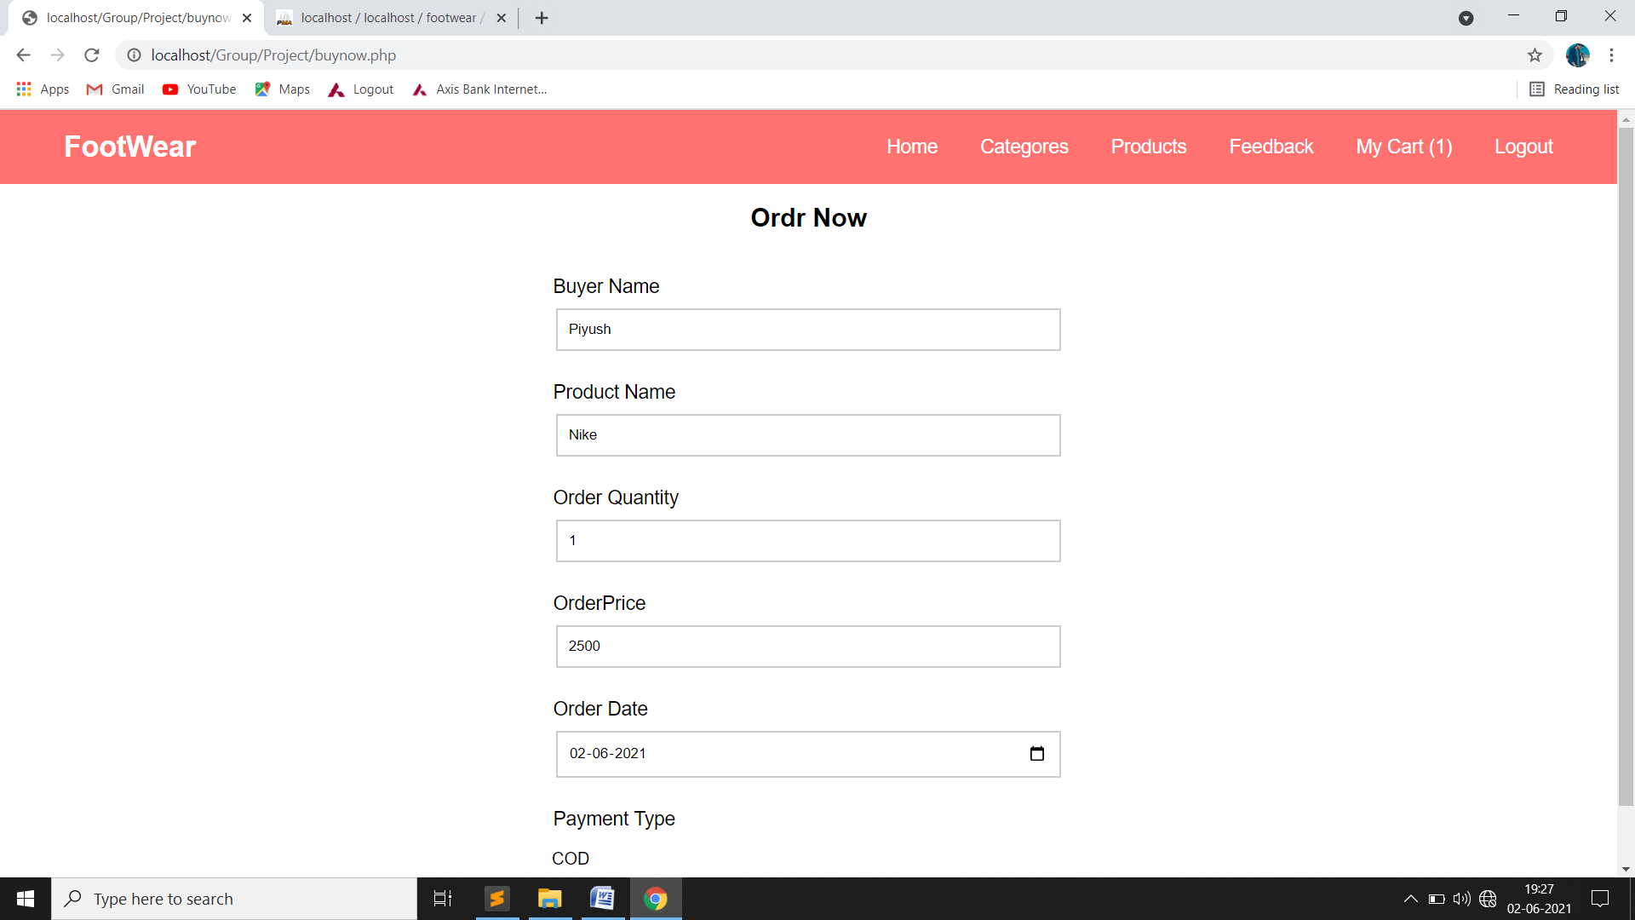
Order Page:-

Slide 91
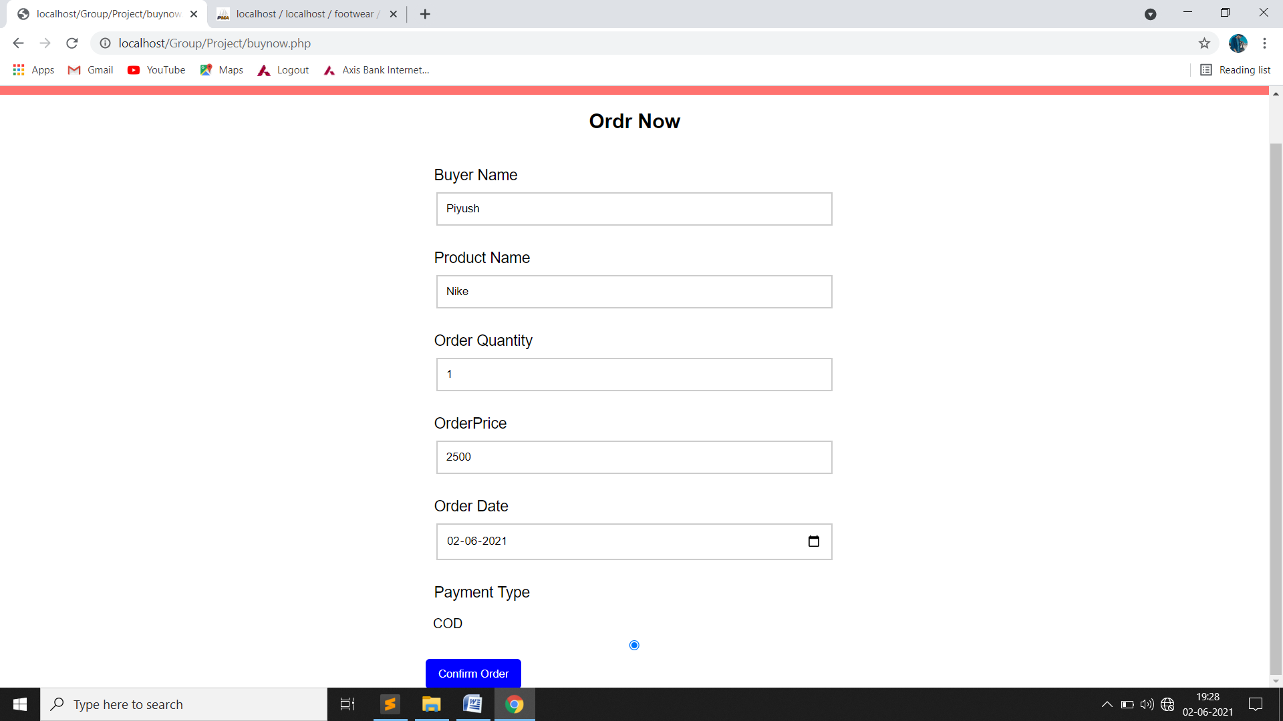

Slide 92
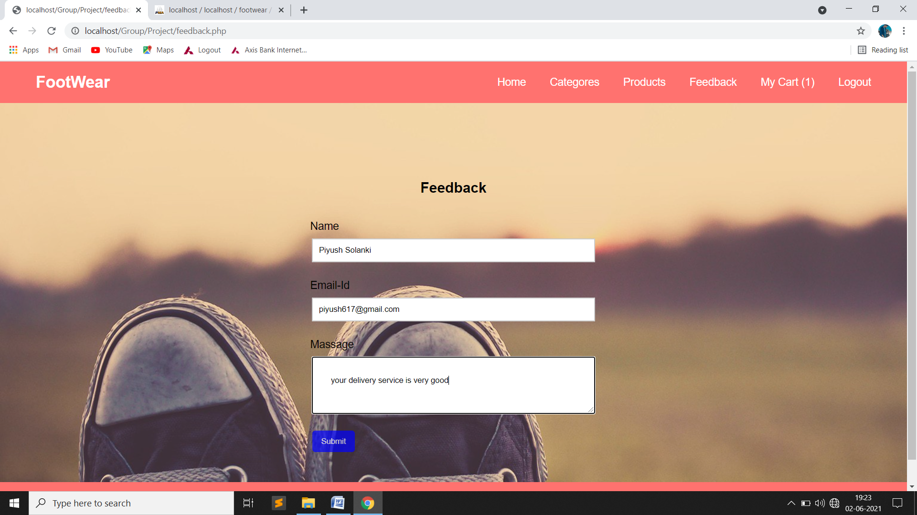
Feedback Page:-

Slide 93
TESTING OF THE SYSTEM

Slide 94
Testing Of The System:
Website Testing Strategies
Testing is a set of activities that can be planned in advanced and conducted systematically. A strategy for website testing must accommodation low-level tests that are necessary to verify that a small source code segment has been correctly implemented as well as high-level tests that validate major system functions against customer requirements
There are three types of testing strategies
Unit test
Integration test
3. Performance test
Unit Testing:
Unit testing focuses verification efforts on the smallest unit of website design module. The unit test is always white box oriented. The tests that occur as part of unit testing are testing the module interface, examining the local data structures, testing the boundary conditions, execution all the independent paths and testing error-handling paths.
Integration Testing:
Integration testing is a systematic technique or construction the program structure while at the same time conducting tests to uncover errors associated with interfacing. Scope of testing summarizes the specific functional, performance, and internal design characteristics that are to be tested. It employs top-down testing and bottom-up testing methods for this case.
Performance Testing:
Timing for both read and update transactions should be gathered to determine whether system functions are being performed in an acceptable timeframe.

Slide 95
CONCLUSION

Slide 96
Conclusion:
That time first you have also verified the input is correct and system output is accurate. You also run the system and debug the system through the live data.
That is our first live project through software engineering. To accomplish the target we followed SYSTEM DEVELOPMENT LIFE CYCLE (SDLC) approach.
During analysis we used fact-finding method in which first we studying the documents, taking interviews of organization staff to take the information about organization, and then observed the manual system. The organization staff has spent some time to give brief ideas to complete the system.
It was an exciting moment for us. We also get some experience about the organization work and developing system. We do not show many tasks from them. It is very useful to us in our future.
Now we feel so much pleasure and get so many ideas about the database management and software engineering and coding.

Slide 97
BIBLIOGRAPHY

Slide 98
Bibliography:
Website Reference:
www.Google.com
www.w3school.com
Book Reference:
PHP With MySQL
Www.Microsoft.Com

Slide 99
THANK YOU...

